Slide 1
Lesson one:
The UK- Building a picture

Slide 2
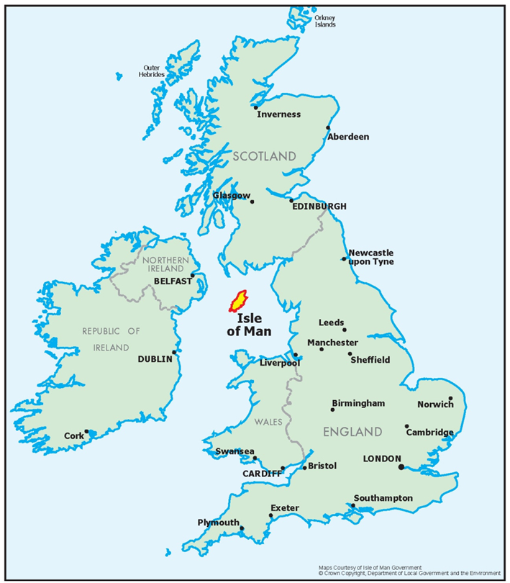
Country Groupings: British Isles
Notes:
Google images: …Love God – Love People – Love Life… jonathanstanfield.com. Accessible at: https://lovegodlovepeoplelovelife.files.wordpress.com/2011/12/map_british_isles.jpg

Slide 3
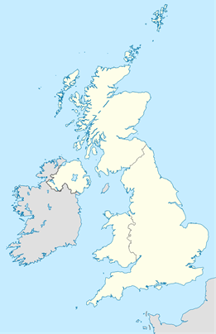
Country Groupings: United Kingdom
Wikipedia Commons
Notes:
Google images: Nuclear Power in the United Kingdom, Wikipedia. Accessible at: https://upload.wikimedia.org/wikipedia/commons/3/3f/United_Kingdom_location_map.svg

Slide 4
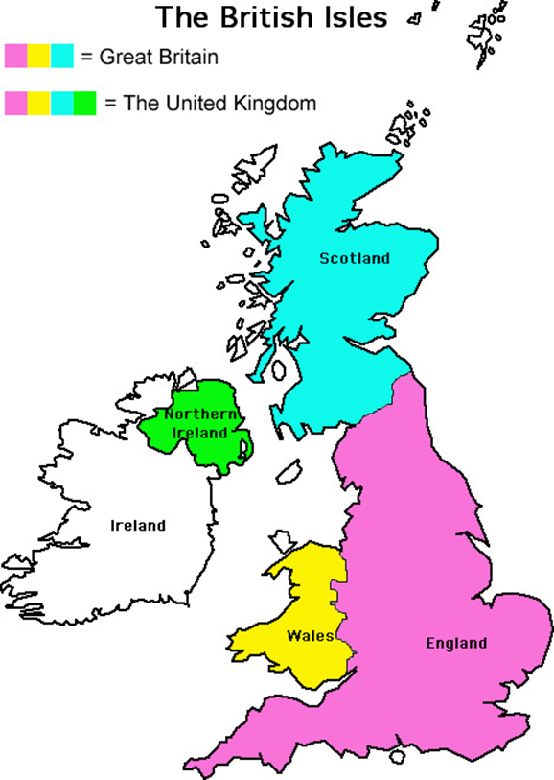

Country Groupings: Differences
Source: Lucien Goubert School
Notes:
Google images: Map of the British Isles, The English blog for Lucien Goubert School. Accessible at: http://eslcollege.blogspot.co.uk/p/documents-6e.html

Slide 5
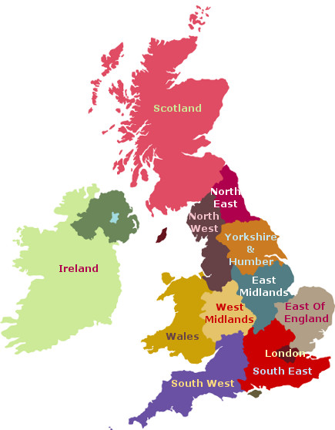
UK Regions
Northern
Ireland
Wikipedia Commons

Slide 6
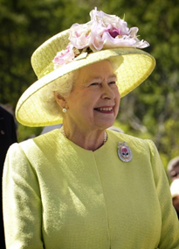
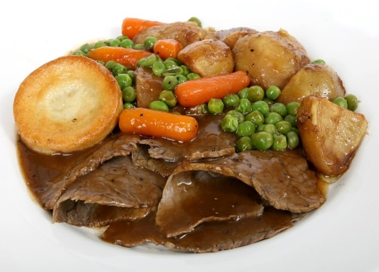
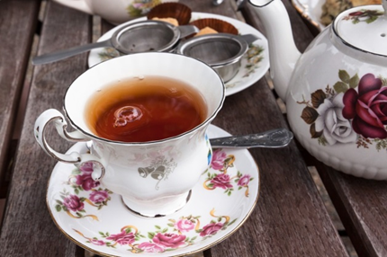
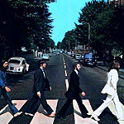
Capital Cities: London, England
Traditional Food
Traditions
Pixabay
Pixabay
Wikipedia Commons
Music
beatles maniac11 © Flickr
Notes:
Traditional English Food – Pixabay: Abstract Beef Britain British Brown Carrots, Meditations. Accessible at: https://pixabay.com/en/abstract-beef-britain-british-1239042/
https://en.wikipedia.org/wiki/Elizabeth_II#/media/File:Elizabeth_II_greets_NASA_GSFC_employees,_May_8,_2007_edit.jpg
Pixabay: Tee Service Earl Grey Teacup Teapot Tea Infuser, stux. Accessible at: https://pixabay.com/en/tee-service-earl-gray-teacup-419320/

Slide 7

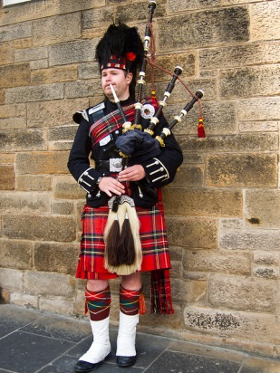
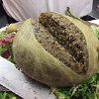

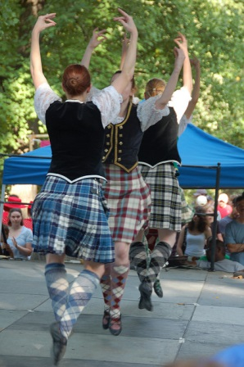
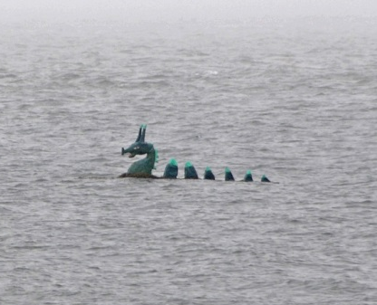
Capital Cities: Edinburgh, Scotland
Flag
Traditional Food
Music
Haggis © tjmwatson, Flickr
Edinburgh piper © david.nikonvscanon, Flickr
Traditions
Loch Ness Monster on Holiday © archer10, Flickr
Scottish Dancing © Herkie, Flickr
Notes:
Flag – Pixabay: Scotland Flag Country United Kingdom Scottish, ClkerFreeVectorImages. Accessible at: https://pixabay.com/en/scotland-flag-country-united-28511/
Sport – Google Images: Can You Name These Bizzare Sports, www.playbuzz.com. Accessible at: https://www.google.co.uk/search?site=imghp&tbm=isch&q=caber+toss&tbs=sur:fmc&gws_rd=cr&ei=9WD6Vo_gHsOxa9vdjcAC#gws_rd=cr&imgdii=O6TTLGhFf8r-BM%3A%3BO6TTLGhFf8r-BM%3A%3B7ropWXd75gxXlM%3A&imgrc=O6TTLGhFf8r-BM%3A

Slide 8

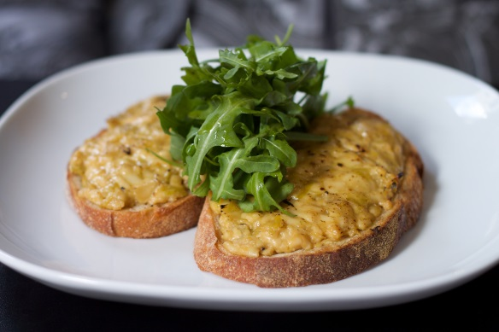

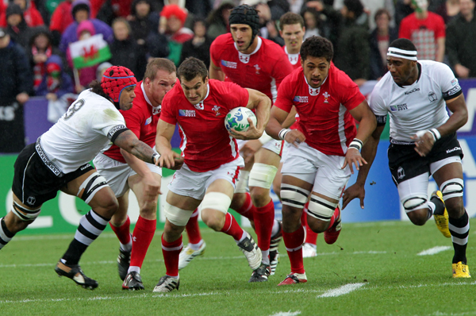
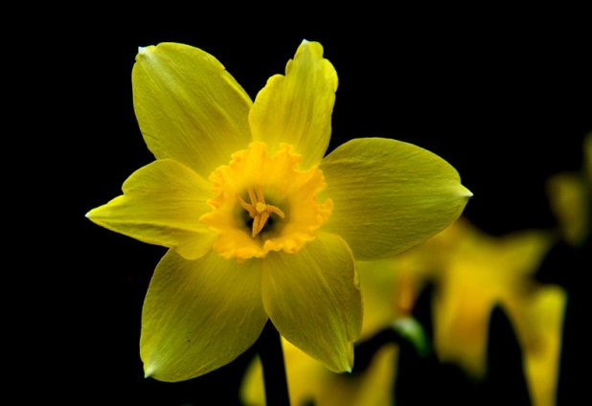
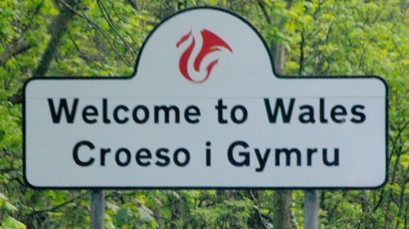
Capital Cities: Cardiff, Wales
Flag
Traditional Food
Music
Wikipedia Commons
Welsh Rarebit © tristankenny, Flickr
Harp © adil113, Flickr
Sport
Traditions
© shrinkingwmn
Wikipedia Commons
Daffodil Flower Yellow Flower © szjeno09190, Pixabay:
Notes:
Sport – Google Images: File:Rugby world cup 2011 wales fidji 6 octobre 2011 – 7309567176.jpg. Accessible at: https://upload.wikimedia.org/wikipedia/commons/f/fc/Rugby_world_cup_2011_wales_fidji_6_octobre_2011_-_7309567176.jpg
Welcome to Wales - No border control, just a welcome sign, theamazingshrinkingwoman.com. Accessible at: https://shrinkingwmn.files.wordpress.com/2014/08/wales.jpg

Slide 9
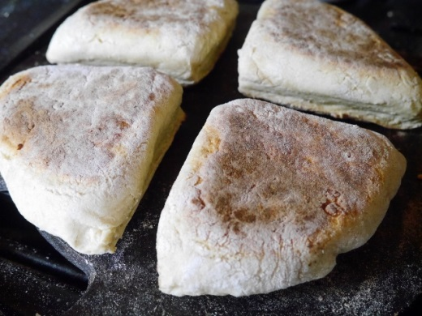
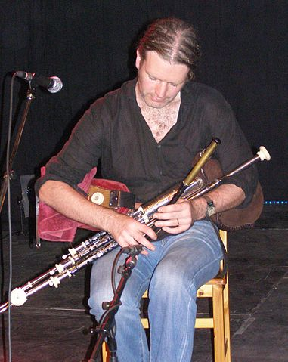
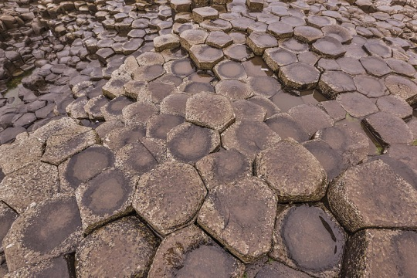
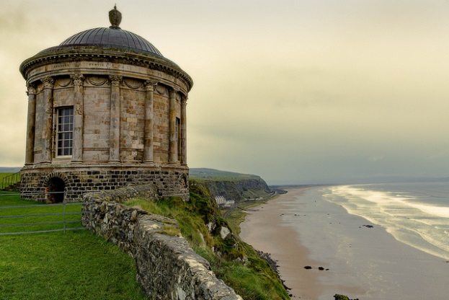
Capital Cities:
Belfast, Northern Ireland
Traditional Food
Music
Giants Causeway
Soda Farls © Weebirdie’s Cafe
Uileann Pipes, Wikipedia Commons
Traditions
Mussenden Temple and Downhill Beach © John.purvis, Flickr
Notes:
Flag – Google Images: File: Saint Patrick’s flag for Northern Ireland crowned.svg, commons.wikimedia.org. Accessible at: https://upload.wikimedia.org/wikipedia/commons/3/3b/Saint_Patrick%27s_flag_for_Northern_Ireland_crowned.svg
Food – Google Images: Soda Farls – Weebirdie’s Cafe. Accessible at: https://weebirdiecafe.files.wordpress.com/2014/03/p1060951-640x481.jpg
Giants Causeway https://www.flickr.com/people/87296837@N00

Slide 10
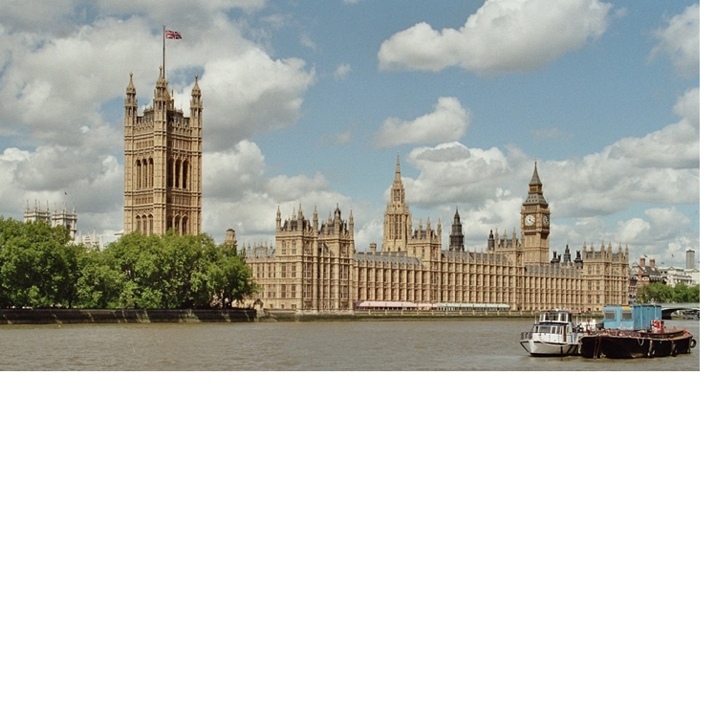

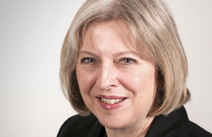
Political Structure: England
Houses of Parliament
Theresa May
Prime Minister of England
Wikipedia Commons
Notes:
Traditional English Food – Pixabay: Abstract Beef Britain British Brown Carrots, Meditations. Accessible at: https://pixabay.com/en/abstract-beef-britain-british-1239042/

Slide 11
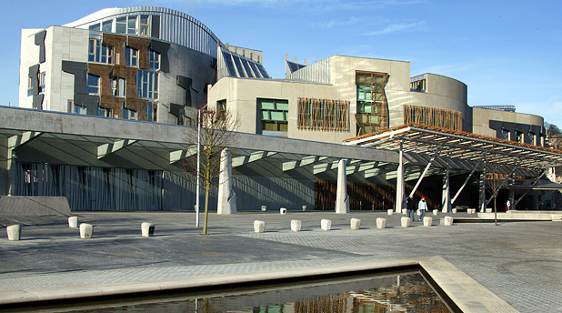
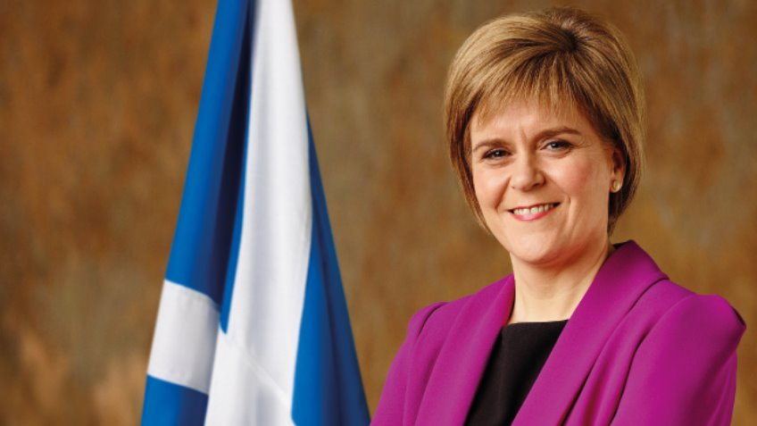
Political Structure: Scotland
Scottish Parliament
The List
Crowdfunder
Nicola Sturgeon, Scotland’s First Minister
Notes:
Scottish Parliament – Google images: The Scottish Parliament (Horse Wynd, Edinburgh), The List. Accessible at: https://files.list.co.uk/images/s/3e5v9389.jpg
Google images: Re-elect Nicoa Stugeon MSP for Glasgow Southside, crowdfunder.co.uk. Accessible at: http://www.crowdfunder.co.uk/uploads/projects/36220.jpg?v=1448272407

Slide 12
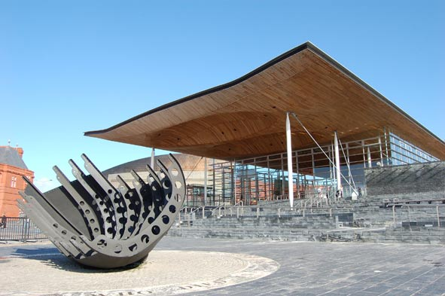
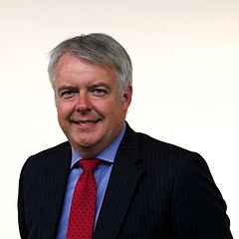
Political Structure: Wales
National Assembly for Wales
Carwyn Jones
First Minister of Wales
Mental Health Wales
Wikipedia Commons
Notes:
Google images: News and Announcements, www.mentalhealthwales.net. Accessible at: http://www.mentalhealthwales.net/mhw/images/Senedd.jpg
Google images: File:Carwyn Jones 2011.jpg, commons.wikimedia.org. Accessible at: https://upload.wikimedia.org/wikipedia/commons/thumb/d/d7/Carwyn_Jones_2011.jpg/240px-Carwyn_Jones_2011.jpg

Slide 13
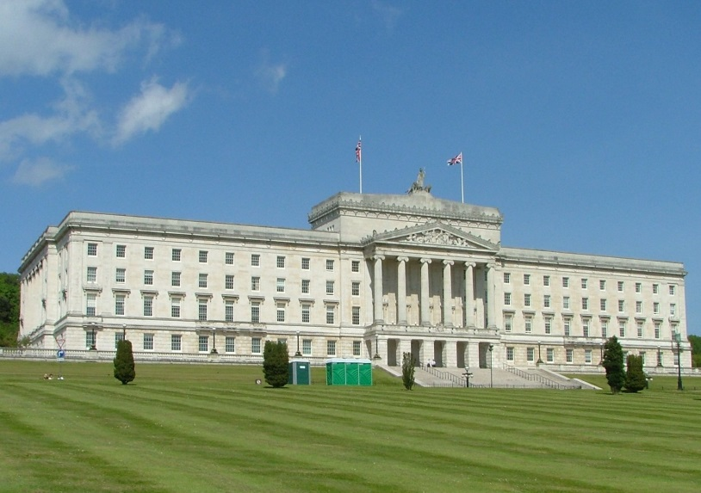
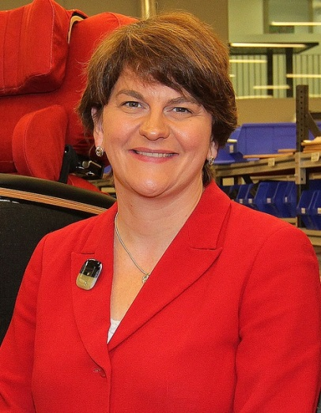
Political Structure: Northern Ireland
Stormont
Arlene Foster, First Minister of Northern Ireland
Notes:
Stormont Parliamentary Building 01.jpg, commons.wikimedia.org. Accessible at: https://upload.wikimedia.org/wikipedia/commons/4/45/Stormont_Parliamentary_Building_01.JPG
Google images: File:MLA Arlene Foster.jpg, commons.wikimedia.org. Accessible at: https://upload.wikimedia.org/wikipedia/commons/8/8c/MLA_Arlene_Foster.jpg

Slide 14
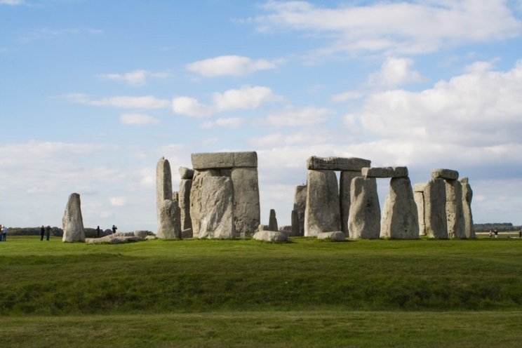
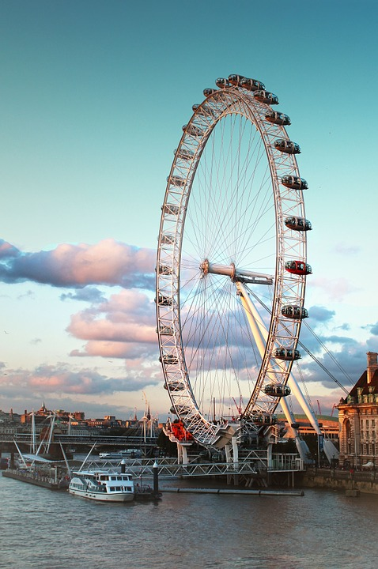
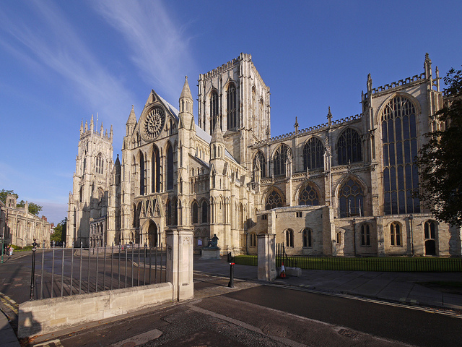
Iconic Landmarks: England
Stonehenge
London Eye
Stonehenge Ruins Ancient England Monument Stone, venturaartist, Pixabay
York Minster
England London Eye Trip Clouds Sku London Eye 964424, Pixabay
York Minster, Early Morning, autumn © John Robinson, Flickr
Notes:
Pixabay: England London Eye Trip Clouds Sku London Eye, 964424. Accessible at: https://pixabay.com/en/england-london-eye-trip-clouds-750407/
Pixabay: Stonehenge Ruins Ancient England Monument Stone, venturaartist. Accessible at: https://pixabay.com/en/stonehenge-ruins-ancient-england-666614/
Flickr: York Minster, Early Morning, autumn, John Robinson (robbophotos). Accessible at: https://www.flickr.com/photos/robbophotos/6204851515/in/photolist-asiubx-5WQNEF-5WV29h-dmpES-5WQLVz-5WV2t1-6P9zZJ-cwRFEN-5WQMjv-39NTMx-8b4FJF-cwRM6A-77ePRV-d1jsJ-asiijt-ayoX4D-6P5nki-askY1y-asm6bG-iT9MKp-asimKa-pcdEmG-iTcFiQ-5ok49X-iTaZp3-bWhWva-ePpyaF-aoWbq8-eNgFdk-nSWxWY-iTaY1b-ePAZ3L-aDPMKz-79JUFH-cwRPn5-7MAEcz-8wfsoz-iTat56-iTbCPx-iTbfEx-q7sz6R-q7sASX-pQeXAu-iTbbPM-iTb1gH-iTacVB-6RVpG-aqEdJy-eNt7as-iT8NMg

Slide 15
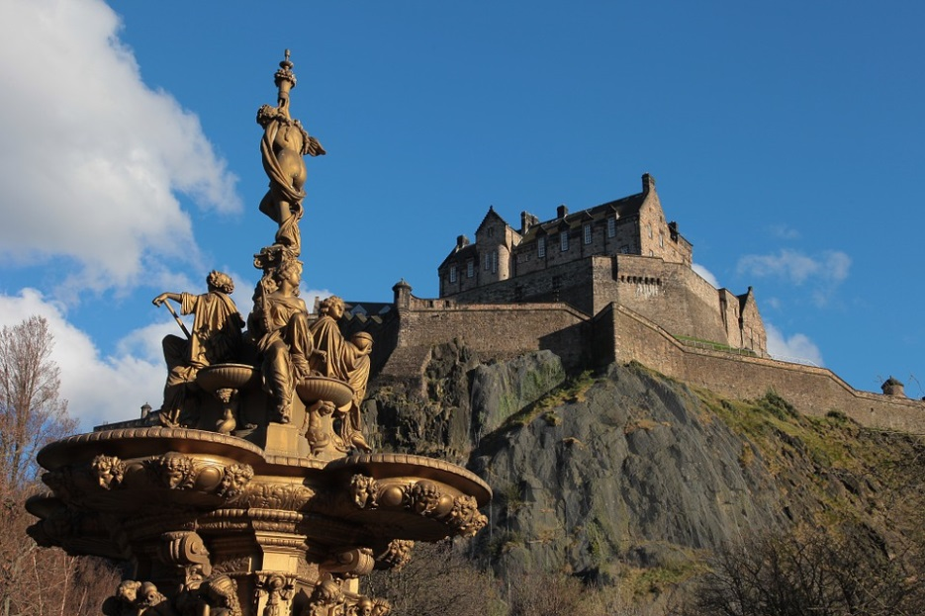
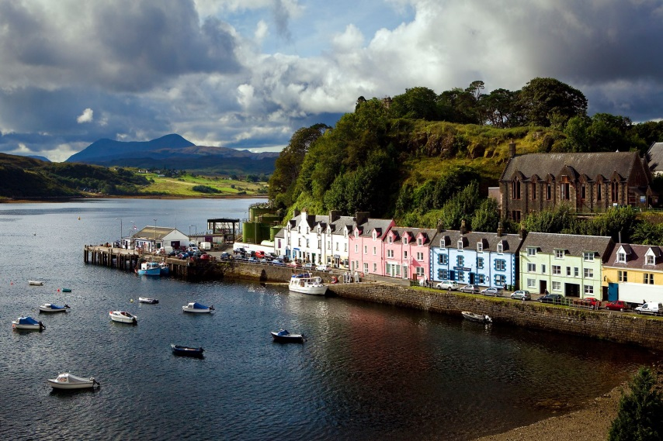
Iconic Landmarks: Scotland
Isle of Skye
Edinburgh Castle
Edinburgh Castle Fontana © aircaloch, Pixabay
Scotlandnow
Notes:
Pixabay: Edinburgh Castle Fontana, aircaloch. Accessible at: https://pixabay.com/en/edinburgh-castle-fontana-366272/
Google images: portree named ‘one of the most beautiful small towns to visit in Europe, www.scotlandnow.dailyrecord.co.uk. Accessible at: http://i2.scotlandnow.dailyrecord.co.uk/incoming/article3613479.ece/ALTERNATES/s1227b/CS15319338.jpg

Slide 16
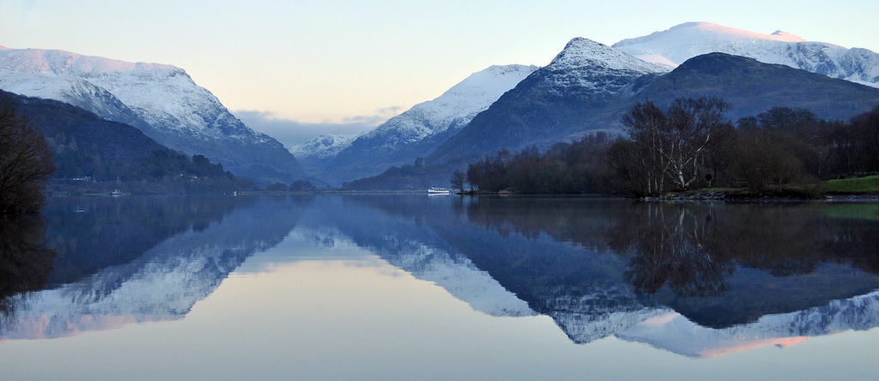
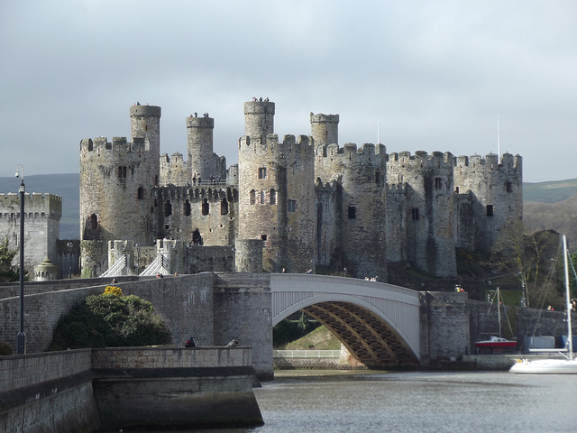
Iconic Landmarks: Wales
Snowdonia
Conway Castle
Beautiful sunset over Snowdonia © Hefln Owen, Flickr
Conway Castle © aegidian, Flickr
Notes:
Google images: Beautiful sunset over Snowdonia, Hefln Owen. Accessible at: https://c1.staticflickr.com/9/8603/16341670201_399f804669_b.jpg
Flickr: Conway Castle, Giles Williams (aegidian). Accessible at: https://www.flickr.com/photos/aegidian/16447809413/in/photolist-c8iERh-emHcwm-7S8qL8-7S8qbv-wbJRLt-5BY2Gi-wqV72q-qWPiUq-wqVnR1-wqV3Tb-wbCcUQ-7SbHcE-r4rjGV-pLVgRK-pM1kp7-8jEcwu-8jB9ST-6oeMRe-8jBb8Z-8jEgYo-a5Pa6N-8jEiwb-5WkAhA-aCeLrP-4RUVvJ-7SbHrb-7SbDxm-7SbFWS-7SbASG-efMjXa-figzXs-5Wgi5t-5Wgi1c-6PnB2Z-KCp7u-5WgifZ-5WkABJ-5WkzHU-5Wkzy1-5WghUT-7SbFz9-o3CYqe-oi6Bto-7SbGAw-8jBfoX-uaKKo-pssegj-8UvanC-7S8iVH-5WghFn

Slide 17
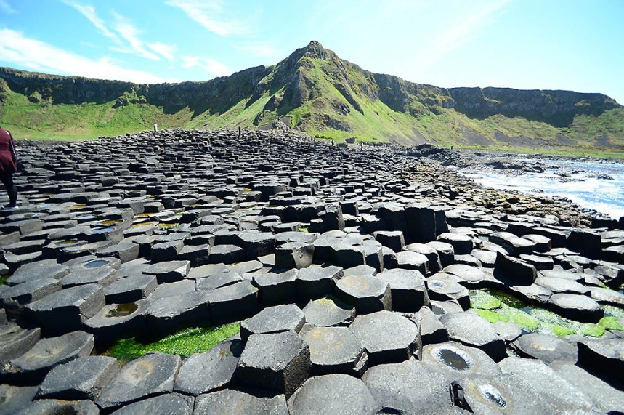
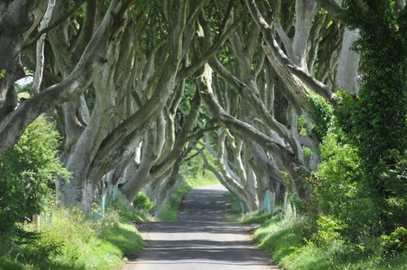
Iconic Landmarks: Northern Ireland
The Giant’s Causeway
The Dark Hedges
© ulearnschool
Dark Hedges of Armoy © horslips5, Flickr
Notes:
Google Images: Trip to the Giant’s Causeway, www.uleamschool.com. Accessible at: http://www.ulearnschool.com/blog/wp-content/uploads/2015/07/The-Giants-Causeway.jpg
Flickr: Dark Hedges of Armoy, horslips5. Accessible at: https://www.flickr.com/photos/67165210@N00/7570155728/in/photolist-o1bF8A-cwX2ym-vh9oeQ-vh9k1A-cwX2QS-Abi2To-nHQvtX-o1ck45-o1bJkh-o11xTz-o36yXD-vWy1EN-aCL7AE-nHP72v-em647j-nwNDyc-nwPFzo-nwPGAG-nfiRW4-nwx4SG-6ykSLu-cwX1K3-nXUT3F-ahUtKo-wdvKNo-cwX38s-qFR3g5-ai134D-cwX28W-cwX1nf-cwX3t9-cwWZN5-weaAuR-weADrP-vh9qm5-vWxSsd-ntWGFS-ahREY2-ahUtjC-CCA1xh-ahUtYL-ahRFyn-cMPWQh-ahRF5t-cMPWkQ-nFHFN3-ahRFiF-ugmzBA-nwvg92-ai12SP

