Slide 1
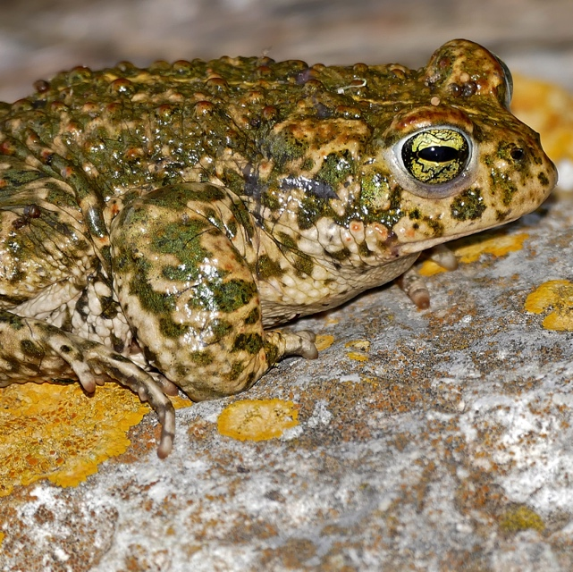
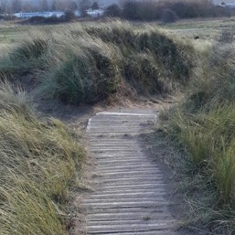
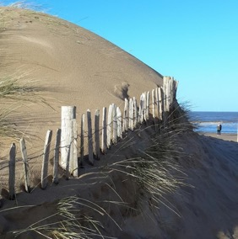
Integrating Professional River Study Techniques into School Fieldwork
Project 2:
Dune Habitats and Human Management
Notes:
Images:
(left) Natterjack toad. Image by Bernard Dupont (https://www.flickr.com/photos/berniedup/40768303714). Image licence: CC-BY-SA 2.0
(centre & right) Management of Talacre Dunes. Images courtesy of RGS-IBG. Image licence: CC-BY-SA 4.0

Slide 2
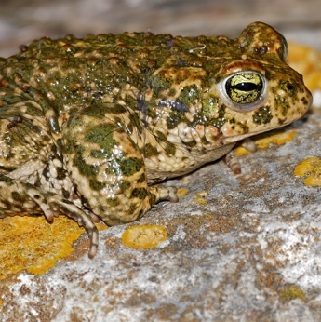
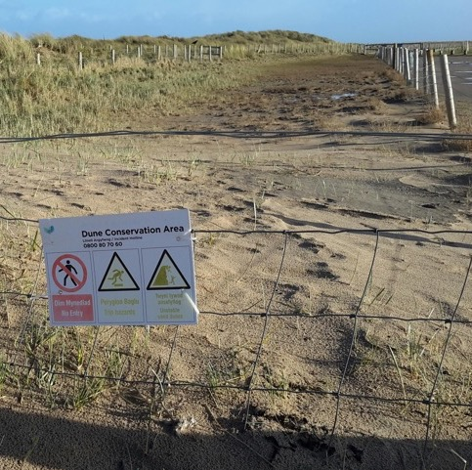
Background & Introduction
Dune systems provide critical coastal functions
Natural defence against flooding
Habitat for a variety of species
Tourism and leisure sites for local communities
Given their importance and sensitivity, most natural dune systems in the UK are under some form of dune management
Monitoring of flora and fauna
Creation of habitats to support and/or re-introduce flora and fauna
Soft engineering to support dune structures and reduce erosion
Visitor management to reduce human impacts
Notes:
Images:
(left) Natterjack toad. Image by Bernard Dupont (https://www.flickr.com/photos/berniedup/40768303714). Image licence: CC-BY-SA 2.0
(right, top & bottom) Active management (pathways, flooded car park, car park blocked off for regeneration). Images courtesy of RGS-IBG. Image licence: CC-BY-SA 4.0

Slide 3
‘Real-world’ Examples
Professional coastal surveys often use stringent methodological protocols and expensive, high-tech equipment (e.g., remote sensing)
2016 study that used remote sensing to monitor changes in coastal dune vegetation in Canada. The automated classification system using remote sensing images was 97% accurate.
BUT
Many coastal river analysis approaches available to GCSE and A Level students are the same or directly comparable to those used by ‘real-world’ practitioners
2005 guidance on the monitoring sand dune habitats in the UK. Among the methods outlined, the use of small sampling units to identifying vegetation was included
A 2001 impact assessment of sand dune mining in Michigan, including an assessment of dune morphologies, ecological and vegetational characteristics, and socio-economic
A 2017 study of dune ecosystem services as a support for Japan’s sake brewing industry
A 2000 Scottish Natural Heritage guide on managing coastal erosion in dune systems
A 2018 blog exploring negative impacts of ‘soft’ sand dune stabilisation using plants in Oregon
Notes:
Links to examples:
http://jncc.defra.gov.uk/pdf/CSM_coastal_sand_dune.pdf
https://www.michigan.gov/documents/deq/GIMDL-GGGEIS_216135_7.pdf
https://link.springer.com/article/10.1186%2Fs40645-017-0142-9
https://www.nature.scot/sites/default/files/2017-07/Publication%202000%20-%20Beach%20Dunes%20-%20a%20guide%20to%20managing%20coastal%20erosion%20in%20beach%20dune%20systems.pdf
http://geotripper.blogspot.com/2018/08/the-flip-side-of-dune-stabilization.html?m=1
http://dr.library.brocku.ca/bitstream/handle/10464/9290/Brock_Hague_Brodie_2016.pdf?sequence=2

Slide 4
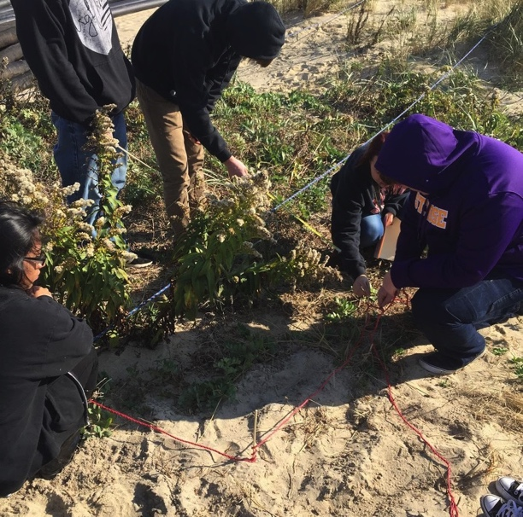
Pre-Fieldwork Activities
Research Questions & Hypotheses
Research should be framed around scientific questions & hypotheses
For example:
Relative levels of biodiversity between different dune sites
Pros and cons of active management in maintaining or re-developing dune habitats
Role of dune habitats in supporting ecosystem services
Relationships between dune morphology and biodiversity
Notes:
Images:
(left) Quadrat sampling. U. S. Fish and Wildlife Service - Northeast Region. Image licence: CC BY 2.0, via Wikimedia Commons
(centre) Gronant & Talacre Dunes. Images courtesy of RGS-IBG. Image licence: CC-BY-SA 4.0

Slide 5
Pre-Fieldwork Activities
Site Selection
Direct access to a managed coastal dune area
At least 2–3 sites within the dune system for comparison
For example:
‘Native’ dune areas with no active management
Sites of dune stabilisation (e.g., fencing, plant introduction)
Areas of salt marsh
Areas of habitat regeneration
Alongside pathways constructed to manage human traffic
Sites impacted by other human infrastructure (e.g., parking areas)
Locations along a transect from the seaward side, through the dunes to landward side

Slide 6
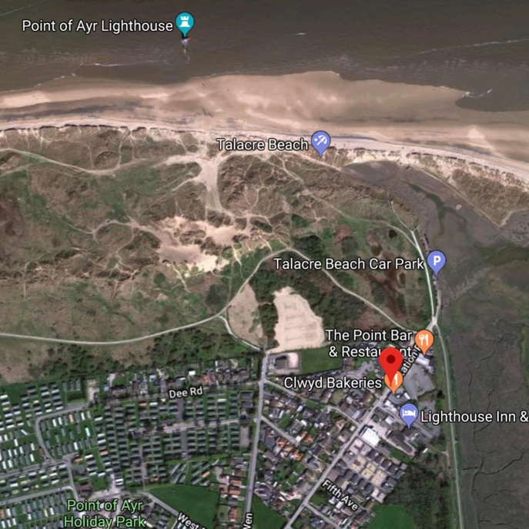
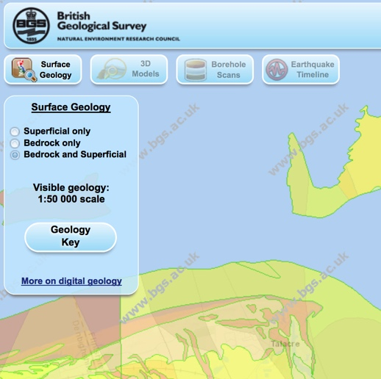
Pre-Fieldwork Activities
Metadata: Cartography
Use maps to identify:
Local and regional scale coastal morphology
Geological setting and impacts on coastal evolution
Proximal natural features/processes
Types of land use and human infrastructure
Land use change over time
For example:
Location on global and UK scale maps (political and topographical)
Current and past Ordnance Survey maps
Geological map of the study area
Current and past aerial /satellite images
Maps of designated (i.e., protected) areas in and around the field area
Environment Agency coastal erosion maps of target areas
Notes:
Images:
(top) Google Maps screen grab (Talacre & Point of Ayr)
(bottom) Screen grab from British Geological Survey (BGS) Geology of Britain geological map (http://mapapps.bgs.ac.uk/geologyofbritain3d/index.html)

Slide 7
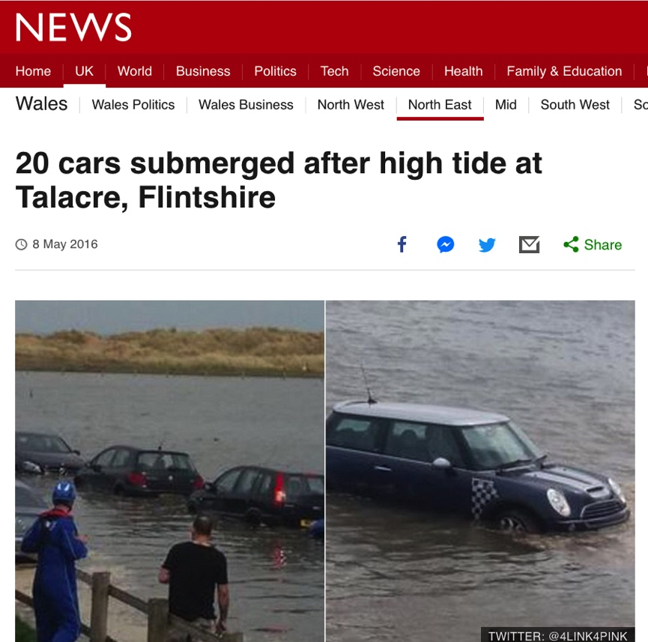
Pre-Fieldwork Activities
Metadata: Other Secondary Data Sources
Environment Agency records and information
Tidal records
Flood risk maps
Media reports
Planning applications
Local guides and publications
e.g., Press coverage of local coastal flooding
Notes:
Images:
- Screen grab of 2016 BBC report on a tidal flooding event at Talacre (http://www.bbc.co.uk/news/uk-wales-north-east-wales-36243086)

Slide 8
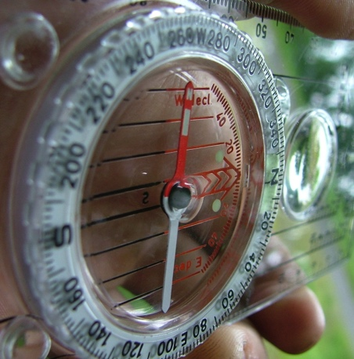
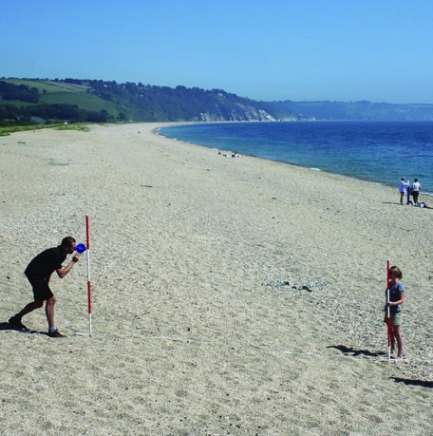
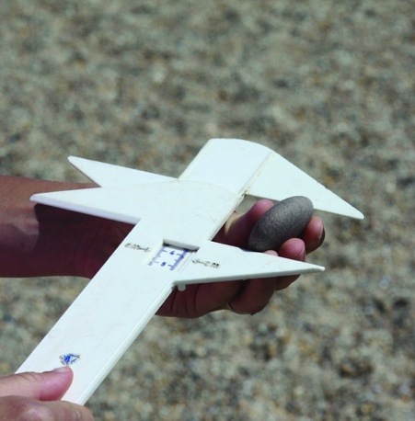
Pre-Fieldwork Activities
Research Techniques
No ‘one size fits all’
Dependent on field area/ field sites
Dependent on features & processes to measure
Dependent on research questions and hypotheses
Dependent on spatial and temporal scales of study
Dependent on available resources (i.e., time, money, expertise)
https://www.rgs.org/schools/teaching-resources/sampling-techniques/
Notes:
Images:
(left) (left) Silva Expedition 4 compass-clinometer (https://en.wikipedia.org/wiki/Silva_compass#/media/File:Silva_compass,_Expedition_4.jpg). Image licence: CC-BY-SA 3.0
(centre) Measuring gradient by the Field Studies Council (https://www.geography-fieldwork.org/a-level/coasts/coastal-management/method/). Image licence: CC_BY
(right) Using callipers to measure the a, b and c axes of a pebble by the Field Studies Council (https://www.geography-fieldwork.org/a-level/coasts/coastal-management/method/). Image licence: CC_BY

Slide 9
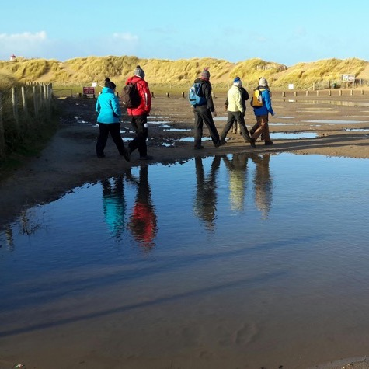
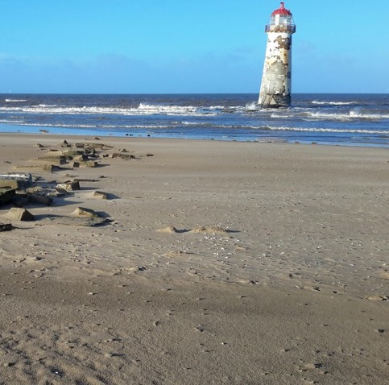
Pre-Fieldwork Activities
Logistical Planning
Field Plan
Dependent on time available
Dependent on number of sites & transit times
Dependent on number of team members
Dependent on data collection techniques
Mitigate impacts of activities on the local environment and habitats, particularly in protected areas (e.g., SSSIs); for example, keep to established paths
Notes:
Images:
(left) Pexels.com (stock photography with a CC0 licence)
(centre) Talacre Beach Lighthouse. Image courtesy of Tornillo Scientific. Image licence: CC-BY-SA 4.0
(right) Group cross flooded car park at Gronant and Talacre Dunes. Images courtesy of RGS-IBG. Image licence: CC-BY-SA 4.0

Slide 10
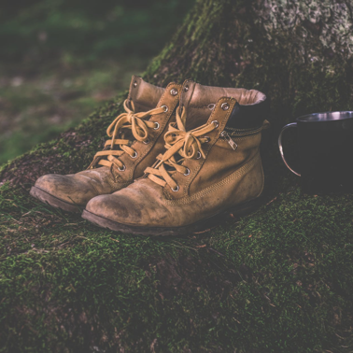
Pre-Fieldwork Activities
Logistical Planning
Field Kit (Universal)
Clothing (long trousers, long sleeves, wet weather gear, boots)
Field note book
Charged mobile phone
GPS device
Camera
Sharpened pencils
First aid kit
Field Kit (Fieldwork Specific)
Research equipment (e.g., metre ruler, callipers, etc.)
Notes:
Images:
- Pexels.com (stock photography with a CC0 licence)

Slide 11
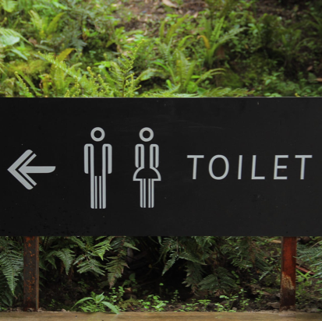
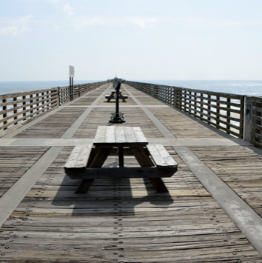
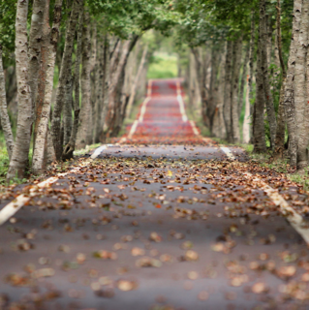
Pre-Fieldwork Activities
Logistical Planning
Site Practicalities
Parking (incl. bus parking)
Toilets
Picnic sites
Shops & cafes
Field centres & visitor centres
Accessibility (roads, foot paths, etc.)
Nearest A&E Department
Notes:
Images:
- Pexels.com (stock photography with a CC0 licence)

Slide 12
Comparative Study of River Regimes Pre-Fieldwork Activities
Products of an evolving planet
Pre-Fieldwork Activities
Logistical Planning
Risk Assessment
Hazard Control Measures Residual Risk
Working near tidal water
Uneven / unstable ground
Biological hazards (dogs, etc.).
Coastal waters will not be entered. Tide schedules consulted before visit. Maintain vigilance. Carry charged mobile phone.
Keep to flat areas; walk with care; ……. etc.
Coastal areas popular with dog walkers. Take precautions around unknown animals (i.e., don't pet dogs without owners’ permission).
MEDIUM
LOW
LOW
https://www.rgs.org/in-the-field/fieldwork-in-schools/fieldwork-safety-and-planning/risk-assessments/
Notes:
Example of factors to consider (NOT exhaustive)

Slide 13
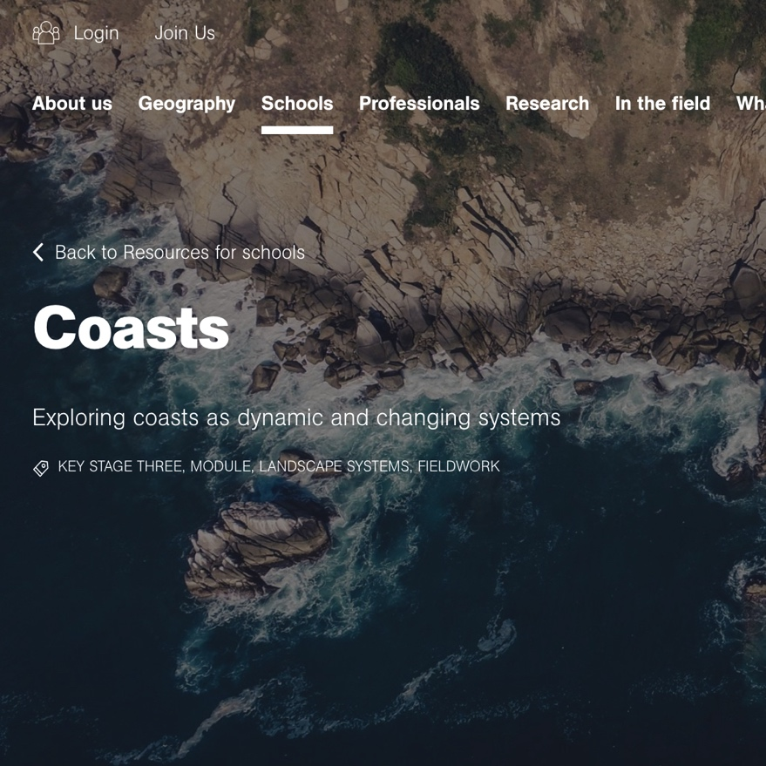
Pre-Fieldwork Activities
Logistical Planning
Other Resources
https://www.rgs.org/schools/teaching-resources/a-student-guide-to-the-a-level-independent-investi/
https://www.rgs.org/schools/teaching-resources/coasts/
https://www.rgs.org/schools/teaching-resources/coastal-processes-and-management/
https://www.rgs.org/schools/teaching-resources/coasts/planning-coastal-fieldwork/
https://www.geography-fieldwork.org/a-level/coasts/coastal-management/method/
Notes:
Image:
- Screen grab from RGS-IBG website (https://www.rgs.org/schools/teaching-resources/coasts/)

Slide 14
Comparative Study of River Regimes Data Collection Technique
Products of an evolving planet
Data Collection Technique
Field Notebook
Critical fieldwork aspect
Record of sites, activities, & data
For professionals, field notebook can be a legal document
Date, time, weather conditions, investigator mood
Name of field site, GPS waypoint name, co-ordinates
Brief site description (e.g., land use, human infrastructure, natural features & processes, vegetation, physical damage, traces of past activity and occupation, areas of vulnerability [e.g., erosion, pollution], evidence for management activities, and other relevant observations)
Identification of coastal defence management strategies with reference to the four UK options for shoreline management: (1) No active intervention; (2) Hold the existing defence line; (3) Managed realignment; and (4) Advance the line
Where possible: recent storm history (days, weeks, months previous)
Site sketch
Record of methods & collected data

Slide 15
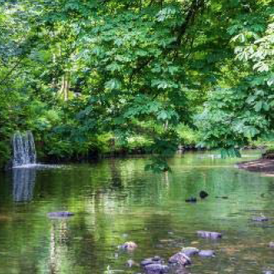
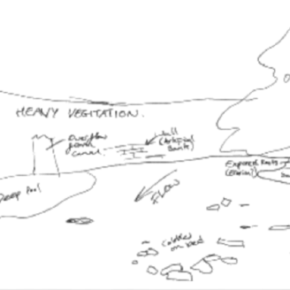
Comparative Study of River Regimes Data Collection Technique
Products of an evolving planet
Data Collection Technique
Field Notebook
Site Sketch Good Practice
Include major features
Sense of scale and spatial distribution of features
Notes:
Images:
- (both) Images courtesy of Environmental Resource Management (ERM)

Slide 16
Products of an evolving planet
Data Collection Technique
Inventory of Dune Features
What is Measured?
Inventory of the main dune features, processes (e.g., evidence for erosion/deposition, etc.) and human infrastructure (e.g., pathways, car parks, old foundations, coastal defence structures)
Make simple visual observations and sketches
Consider the multiple ways that a single process can come about; for example, erosion can be natural (wind erosion scars on dunes) or manmade (unofficial paths through the dunes).
Note: some soft dune engineering may not be immediately obvious (e.g., material inserted into dunes for stabilisation, wooden sand ladders).
Notes:
Images:
(both) Coastal defences (Point of Ayr & Prestatyn). Images courtesy of RGS-IBG. Image licence: CC-BY-SA 4.0

Slide 17
Data Collection Technique
Inventory of Coastal Features
Site Requirements
Any dune location
Ideally, multiple sites along a transect through the dunes, perpendicular to the shoreline, and crossing locations with different management approaches
Alternatively, discrete sites that represent specific management policies or processes may be selected, even if off-transect
Equipment & Costs
Field notebook and pencil (low cost)
Data Resolution Needs
Number of observations will depend on the site and on the number of dune features/processes visible
Professional Measurement Techniques
Basic field site observations are critical for all fieldwork
Professional dune studies may also use secondary data to identify key features (e.g., maps, management reports, etc.).

Slide 18
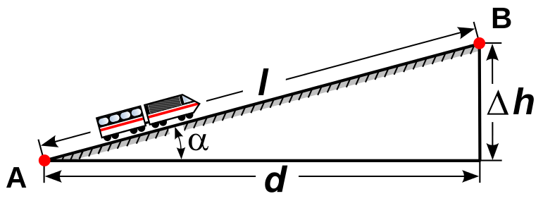
Products of an evolving planet
Data Collection Technique
Dune Morphology (Gradient)
What is Measured?
Dune morphology provides data on the health of the dune system and on the strength of on-going dune processes
Dune morphology is assessed by creating dune profiles from multiple gradient measurements, where gradient is the:
Difference in height between two sites divided by the distance between those sites
Take multiple measurements across each dune. Start a new measurement when there is a significant break in the slope
Place measuring poles a known distance apart (one up-profile, one down-profile, with direct line-of-sight perpendicular to the shoreline)
Take angle between matching height horizons using a clinometer
Calculate gradient from equation:
Gradient = Δh /d
Notes:
Images:
(top right) Measuring gradient by the Field Studies Council (https://www.geography-fieldwork.org/a-level/coasts/coastal-management/method/). Image licence: CC_BY
(bottom left) Madcap, from Wikimedia Commons (https://commons.wikimedia.org/wiki/File:Grade_dimension.svg). Image licence: Image in the public domain.

Slide 19
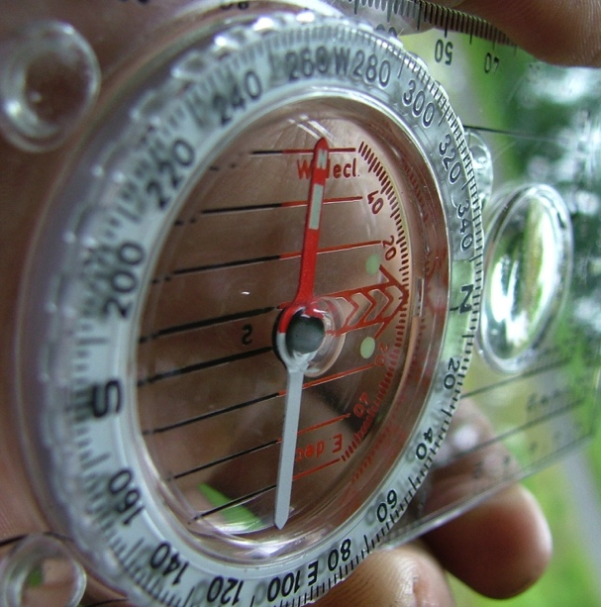
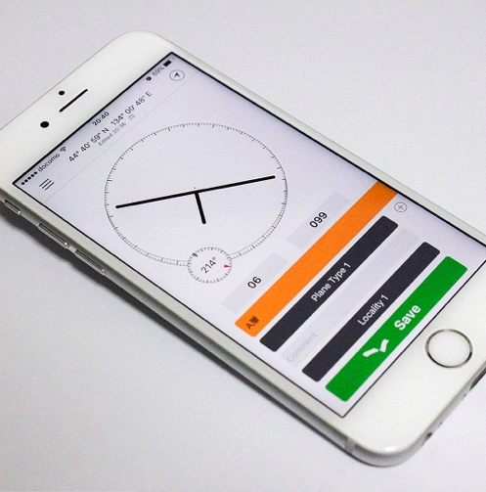
Data Collection Technique
Dune Morphology (Gradient)
Site Requirements
Access to full width of an active dune system
For managed and protected dunes, permission may be needed to venture off designated pathways
Equipment & Costs
Surveying poles (moderate cost) or metre rulers (low cost)
Clinometer: home-made, smartphone app, plastic (all low cost)
Data Resolution Needs
Dune profiles can be continuous across the whole width of the dune system, including multiple dunes, or be performed for individual dunes
Each profile will contain a number of segments. For each segment, repeat the measurement 3–5 times
Calculate an average (mean or median) value
Calculate data spread (e.g., standard deviation)
Notes:
Images:
(top) Silva Expedition 4 compass-clinometer (https://en.wikipedia.org/wiki/Silva_compass#/media/File:Silva_compass,_Expedition_4.jpg). Image licence: CC-BY-SA 3.0
(bottom) Clinometer on a smartphone. Image by Rufiyaa (https://commons.wikimedia.org/wiki/File:Clinometer_on_smartphone.jpg). Image licence: CC-BY-SA 4.0

Slide 20
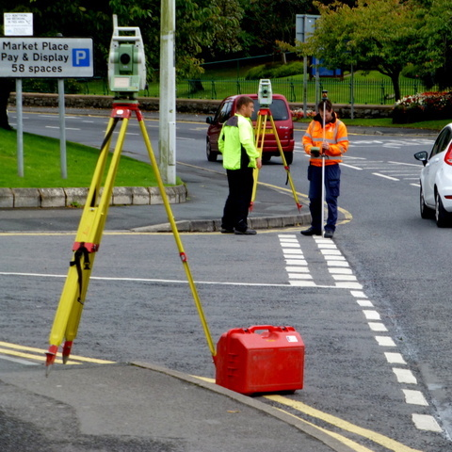
Data Collection Technique
Dune Morphology (Gradient)
Professional Measurement Techniques
Surveying poles & clinometers
Theodolites and laser-based equipment
LiDAR data
Digital Elevation Models (DEMs) derived from aerial & satellite images
Notes:
Image:
- Theodolite surveying in Dublin, Ireland. Image by Kenneth Allen (http://www.geograph.ie/photo/4190504). Image licence: CC-BY-SA 2.0

Slide 21
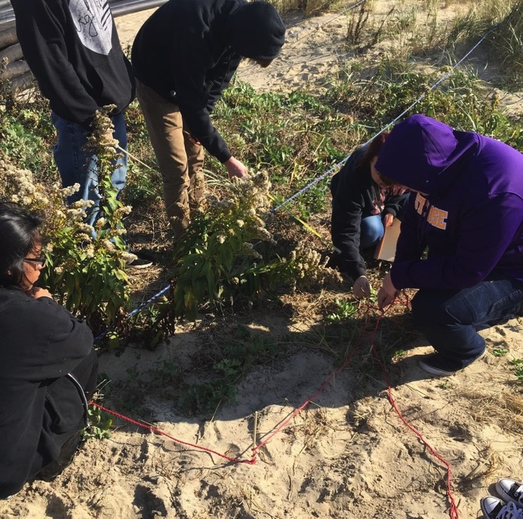
Products of an evolving planet
Data Collection Technique
Species Abundance
What is Measured?
Species abundance provides a quantitative measure of biodiversity in sand dune systems
Measured either as the percentage of area covered by vegetation, or more specifically by the percentages of area covered by specific species of vegetation.
Data are collected from within quadrats placed at regular intervals along a dune transect, or within specific areas of interest within a dune system
The ACFOR scale is commonly used for measuring species abundance within quadrats
A = ABUNDANT (greater than/equal to 30%)
C = COMMON (20% to 29%)
F = FREQUENT (10% to 19%)
O = OCCASIONAL (5% to 9%)
R = RARE (4% or less)
Notes:
Images:
- Quadrat sampling. U. S. Fish and Wildlife Service - Northeast Region. Image licence: CC BY 2.0, via Wikimedia Commons

Slide 22
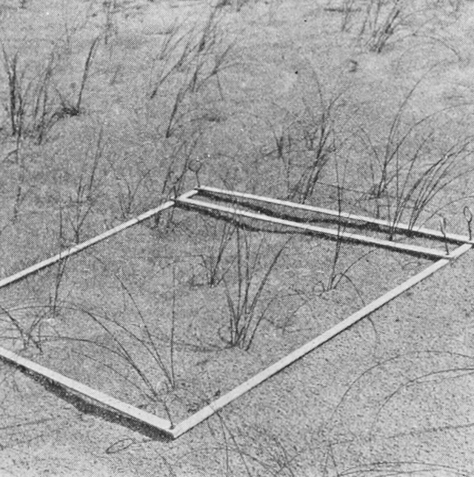
Data Collection Technique
Species Abundance
Site Requirements
Access to full width of an active dune system
For managed and protected dunes, permission may be needed to venture off designated pathways
Equipment & Costs
Quadrats can be purchased cheaply or constructed using simple classroom materials (low cost)
Species identification charts are available for purchase at low cost (e.g., from the Field Studies Council) and may also be available from local educational facilities and field centres
Data Resolution Needs
For each site, place quadrat on the ground randomly (e.g., tossed onto the ground from a short distance away)
Repeat 3–5 times per site to provide average data for each location with an indicator of data spread (e.g., standard deviation)
Notes:
Images:
- Quadrat. Popular Science Monthly Volume 80 1921. Image licence: Public Domain, via Wikimedia Commons

Slide 23
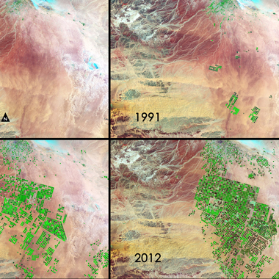
Data Collection Technique
Species Abundance
Professional Measurement Techniques
Remote sensing techniques (e.g., satellite imagery) are increasingly used to monitor changes in vegetation cover, even on very small scales
Quadrat data collection and ground-truthing of satellite imagery remain important tools for field biologists and ecologists (particularly when data on specific species are required)
Notes:
Image:
- Center-pivot irrigation crops in Saudi Arabia. In this series of four Landsat images, the agricultural fields are about one kilometer across. Healthy vegetation appears bright green while dry vegetation appears orange. Barren soil is a dark pink, and urban areas, like the town of Tubarjal at the top of each image, have a purple hue. Image credit: NASA/GSFC (https://landsat.gsfc.nasa.gov/satellites-reveal-major-shifts-in-global-freshwater/). Image licence: NASA content - images, audio, video, and computer files used in the rendition of 3-dimensional models, such as texture maps and polygon data in any format - generally are not copyrighted. You may use this material for educational or informational purposes, including photo collections, textbooks, public exhibits, computer graphical simulations and Internet Web pages.

Slide 24
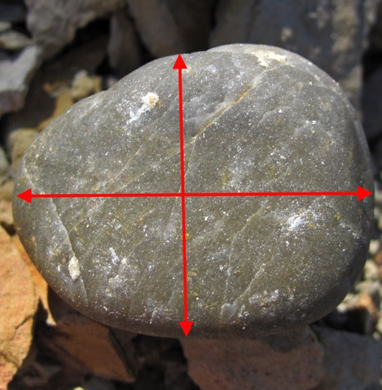
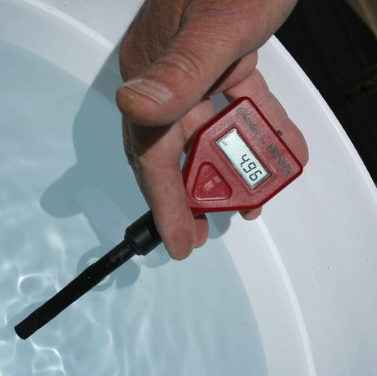
Data Collection Technique
Dune Material Analysis
What is Measured?
The materials (I.e. sand and pebbles) that make up dune material, along with the temperature and pH of the subsurface, can reflect the health of the dune system and can be used to identify sources of pollution and contamination
Sample Selection
Collect samples at regular intervals along a dune-wide transect perpendicular to the shoreline; or, collect samples from different site types (i.e., native dunes, areas of human activity, etc)
Select samples from the surface, or from different depth horizons (e.g., 5 cm, 10 cm) in small trenches or pits
Use callipers or a ruler to measure pebble axes
Qualitatively assess sand grain using a geological grain size chart
Quantitatively assess sand grain size using grain sieves
Temperature and pH
Temperature and pH are best measured in situ using a hand-held digital meter
Notes:
Images:
(top) Image modified from original by James St. John (https://www.flickr.com/photos/jsjgeology/39200485210). Image licence: CC-BY 2.0
(bottom) Digital pH meter. By Ildar Sagdejev [GFDL (http://www.gnu.org/copyleft/fdl.html). Image licence: CC BY-SA 4.0, from Wikimedia Commons

Slide 25
Data Collection Technique
Dune Material Analysis
Site Requirements
Access to full width of an active dune system
For managed and protected dunes, permission may be needed to venture off designated pathways or dig sample pits
Equipment & Costs
Plastic callipers or a ruler (low-cost)
Digital callipers (moderate to high cost)
Sediment sieves (moderate to high cost)
Geological grain size chart (low cost)
Digital pH and temperature meter(s) (low cost)
Data Resolution Needs
At each site along transect, collect a single sediment sample or at least 10 pebbles (per horizon if using pits), and measure pH/temperature at least 5–10 times
For each variable, calculate average (mean or median) value
For each variable, calculate data spread (e.g., standard deviation)
Notes:
Images:
- Using callipers to measure the a, b and c axes of a pebble by the Field Studies Council (https://www.geography-fieldwork.org/a-level/coasts/coastal-management/method/). Image licence: CC_BY

Slide 26
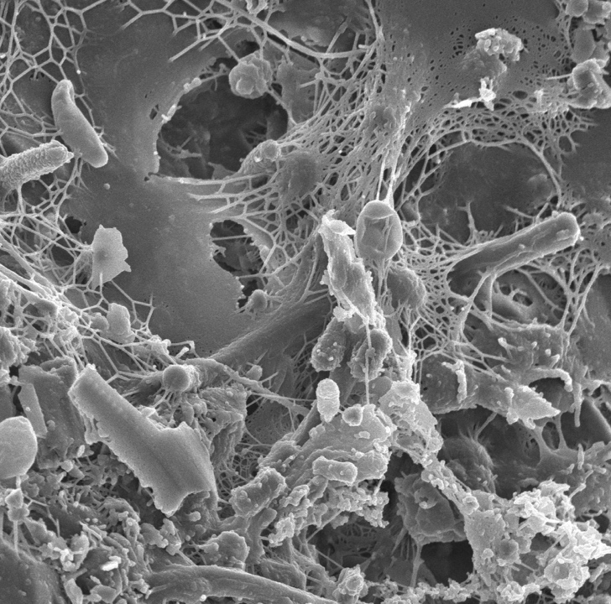
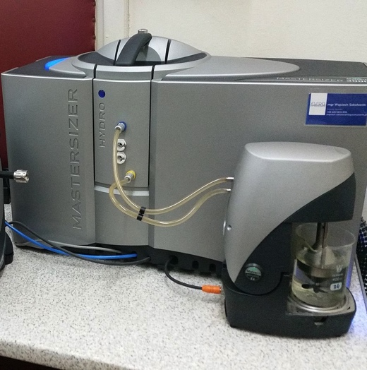
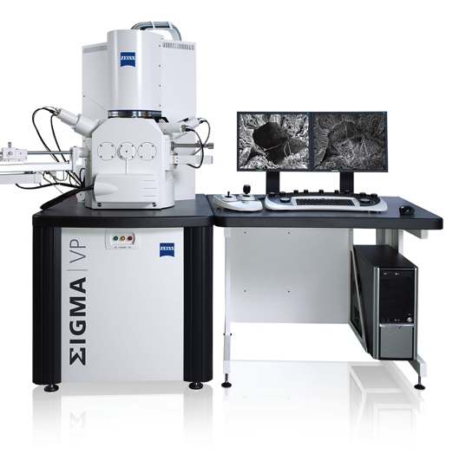
Data Collection Technique
Dune Material Analysis
Professional Measurement Techniques
pH and temperature using portable digital meters
Manual grain-size analysis (e.g., high-precision calliper measurements)
Laboratory-based testing of collected sand and pebble samples
Laboratory testing methods include:
Scanning electron microscopy (SEM; see images) for compositional and morphological analysis of beach material
Laser granulometry for grain size analysis
Notes:
Image:
(right) Sand grains under SEM. Image courtesy of the Lewis Lab at Northeastern University (https://www.flickr.com/photos/adonofrio/albums/72157623620596451). Image created by Anthony D'Onofrio, William H. Fowle, Eric J. Stewart and Kim Lewis. Image licence: CC-BY 2.0
(second to right) Image by ZEISS Microscopy (https://www.flickr.com/photos/zeissmicro/10710025785). Image licence: CC-BY-SA 2.0
(left) Mastersizer 3000 laser granulometer. By Plogeo. Image licence: CC BY-SA 4.0, from Wikimedia Commons

Slide 27
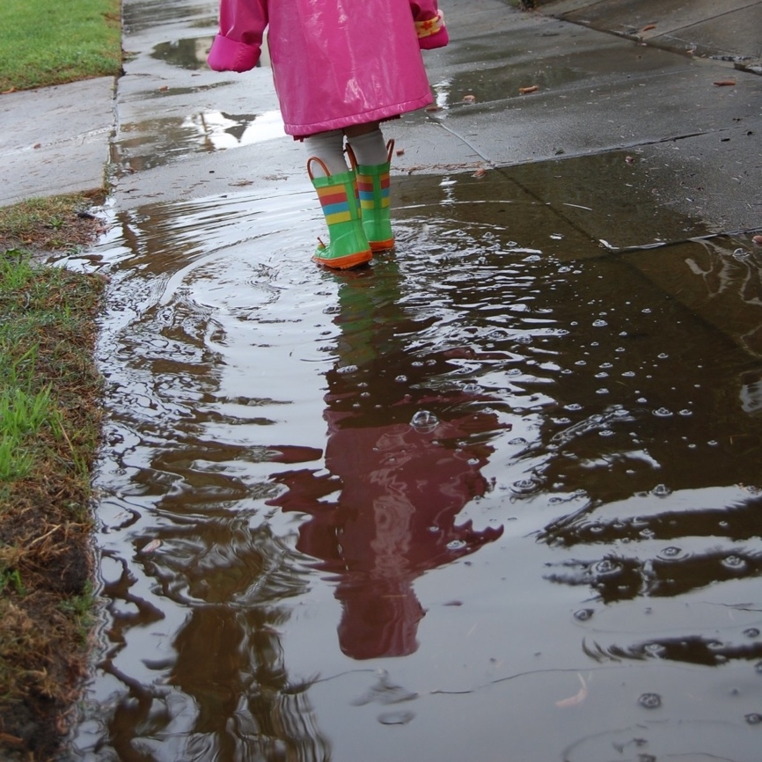
Data Collection Technique
Infiltration
What is Measured?
Water infiltration rates through dune areas can help with the identification of flood risk areas
Time taken for a given volume of water (placed in a section of drainpipe or similar) to drain into the ground
Data should be collected at regular intervals along a dune transect, or at sites of particular interest within the dune (e.g., native dunes, sites of human intervention, etc..)
Notes:
Images:
- Pexels.com (stock photography with a CC0 licence)

Slide 28
Data Collection Technique
Infiltration
Site Requirements
Access to full width of an active dune system
For managed and protected dunes, permission may be needed to venture off designated pathways
Equipment & Costs
Stopwatch (low cost)
Section of drainpipe (or similar item) (low cost)
Data Resolution Needs
Collect data at regular intervals across dune transect, with intervals dependent on dune width and time available
At each spot, measure infiltration time at least 3–5 times
Calculate average (mean or median) time
Calculate data spread (e.g., standard deviation)
Professional Measurement Techniques
Similar to the approach described here

Slide 29
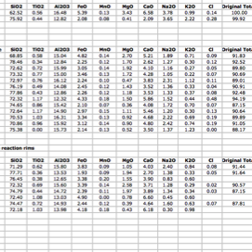
Post-Fieldwork Activities
Data Organisation & Input
For professionals, fieldwork is only the start
Post-fieldwork activities are the longest part of any project
The first step is data organisation and management
Transfer field data to computer or tablet
Consider storage options (e.g., Microsoft Excel, ArcGIS, Google Earth)
For groups, develop data management plan & sharing facilities (e.g., Google Drive, Dropbox)
Notes:
Images:
(left) Microsoft excel screen grab
(right) Screen grab of Dropbox homepage (https://www.dropbox.com/?landing=dbv2)

Slide 30
Post-Fieldwork Activities
Data Analysis & Interpretation
Appropriate use of:
Statistical techniques (e.g., data averaging, data spread, etc.)
Chart types and tables
Spatial analysis (e.g., ArcGIS, which is freely available to UK schools)
Interpretation and analysis should:
Reflect and be supported by the data
Compare and contrast different sites
Consider the results of similar studies & compare data with available secondary data sources
Return to original scientific questions and hypotheses
Consider how results would change under different conditions (e.g., changing seasons)
Consider how results may change in the future (e.g., impacts of climate change, increasing population)
Data limitations should be considered and clearly presented

Slide 31
Post-Fieldwork Activities
Data Analysis: Calculations
Pebble Roundness
Use long and short axes measurements to perform particle shape analysis via pebble roundness indices (e.g., Cailleux Index)
Cailleux roundness (R) = 2r x 1000 / L
L = average length of pebbles
r = average radius of curvature (obtained from a chart)

Slide 32
Post-Fieldwork Activities
Data Analysis & Interpretation
Using data collected in the field and additional metadata:
Consider the positive and negative aspects of the dune management strategies observed (e.g., effectiveness, cost, environmental impact, aesthetics, longevity, etc.)
Identify ecosystem services provided by the dunes; for example, (a) primary production (e.g., biomass as food for other animals); (b) sediment formation and nutrient recycling; (c) provision of resources (e.g., food for human consumption, water filtration, building materials); (d) regulating services (e.g., coastal protection); and (e) cultural services (e.g., recreation, research, education)
Consider past pressures acting on the dune system (e.g., historical activities) and trends in coastline development over time
Assess the extent to which these pressures still impact on the dune today
Consider current pressures and how they may impact on the dunes in the future
Consider possible future pressures (e.g., sea level rise, changes in climate, increase in storm events) and how these may impact on the dune system

Slide 33
Post-Fieldwork Activities
Data Reporting & Sharing
Data sharing and open access is required for some professionals
For others, data sharing is restricted to paid clients
Data sharing & reporting must consider the needs of the audience
Can include written reports, oral presentations, graphical representations
Present at ‘conferences’, where different teams present concurrently using posters or talks
To reach a broader audience:
Webpage creation
Social media & blogging
Citizen science platforms
Notes:
Images:
- Pexels.com (stock photography with a CC0 licence)

Slide 34
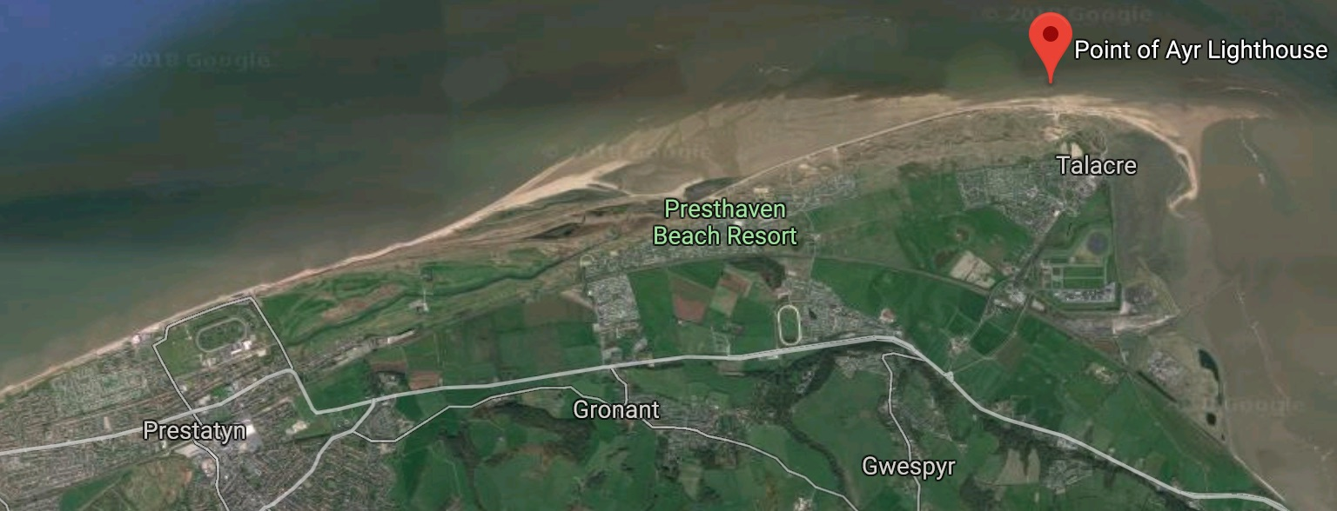
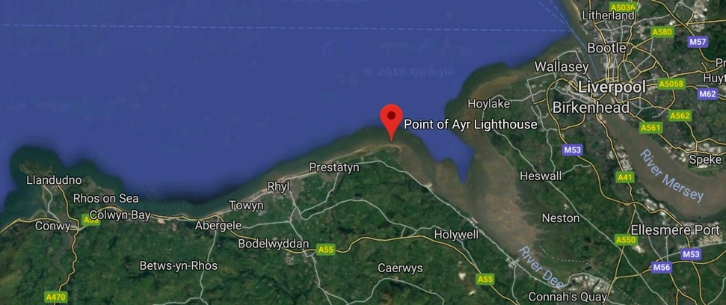
Case Study
Point of Ayr, North Wales
North-easterly most point of Wales
High-energy sandy coastline meets the low energy Dee Estuary
Notes:
Image:
- (all) Google Maps screen grabs (Northeast Wales & Point of Ayr)

Slide 35
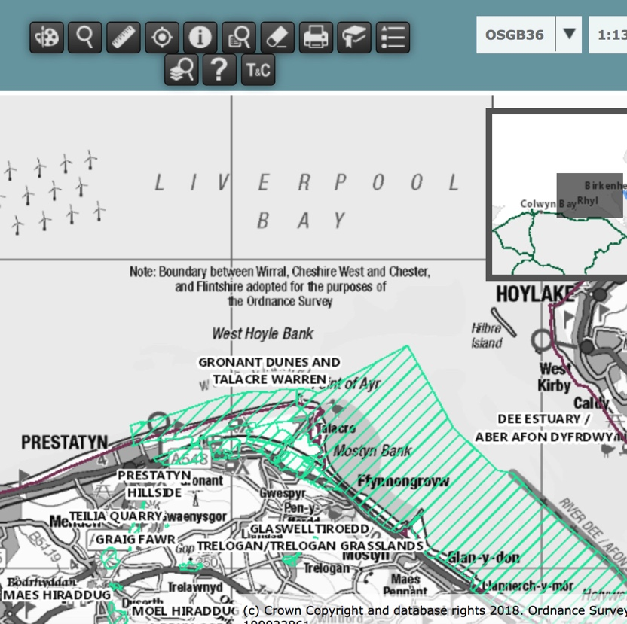
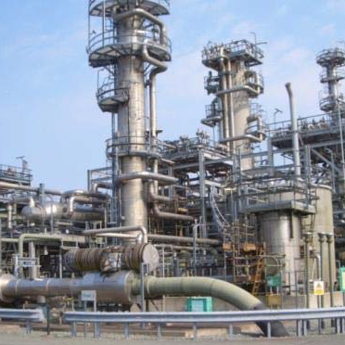
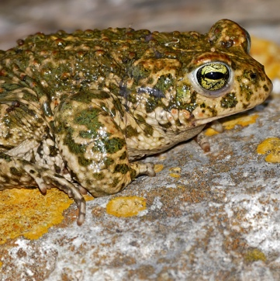
Case Study
Point of Ayr, North Wales
Multiple competing interests
Environment
(Wildlife, dunes & SSSIs)
Industry
(ENI Point of Ayr Gas Terminal)
Notes:
Images:
(top left) Dune management. Images courtesy of RGS-IBG. Image licence: CC-BY-SA 4.0
(bottom left) Natterjack toad. Image by Bernard Dupont (https://www.flickr.com/photos/berniedup/40768303714). Image licence: CC-BY-SA 2.0
(Centre) Screen grab of UK Magic Map showing SSSIs around Point of Ayr (www.natureonthemap.naturalengland.org.uk/magicmap.aspx)
(right) Point of Ayr Gas Terminal. Image courtesy of Environmental Resource Management (ERM)

Slide 36
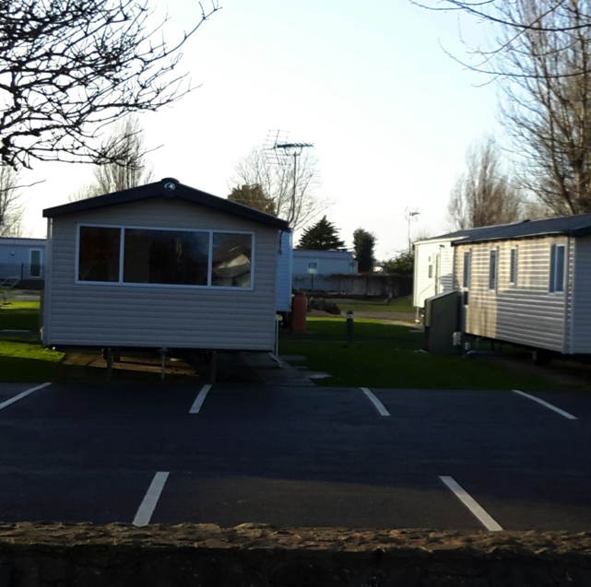
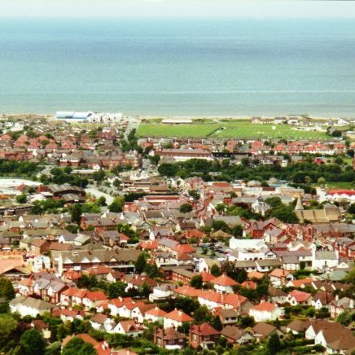
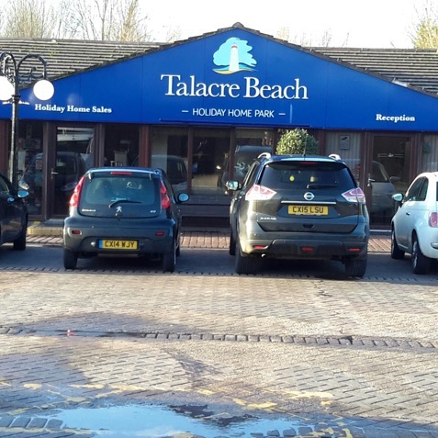
Case Study
Point of Ayr, North Wales
Multiple competing interests
Local residents
(Talacre village/ Prestatyn town)
Tourists
(Talacre holiday park)
Notes:
Images:
(left) Prestatyn, Image by Graham Horn (http://www.geograph.org.uk/photo/724208). Image licence: CC-BY 2.0
(centre & right) Talacre holiday park. Images courtesy of RGS-IBG. Image licence: CC-BY-SA 4.0

Slide 37
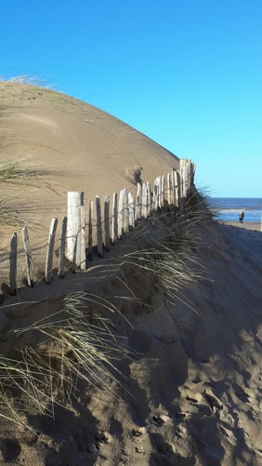
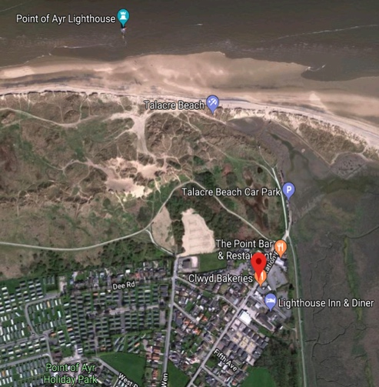
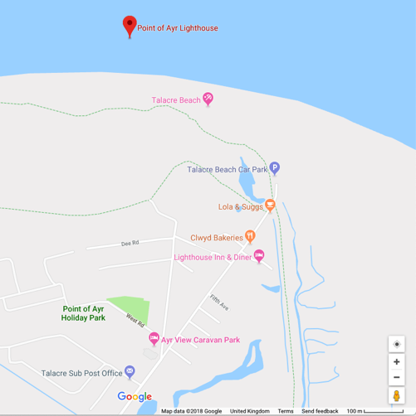
Case Study
Point of Ayr, North Wales
Gronant and Talacre Dunes & Beach (53°21'18.5"N 3°19'02.7"W)
Coastal dune and salt marsh with important coastal protection function
Almost only natural coastline between Dee Estuary and Great Orme
Above gas pipeline from offshore fields to Point of Ayr Gas Terminal
Historical (foundations of chalets to house WW2 evacuees still visible)
SSSI designated for dune system habitats
Popular holiday and leisure location
Notes:
Images:
(left) Gronant & Talacre Dunes. Image courtesy of RGS-IBG. Image licence: CC-BY-SA 4.0
(centre and right) Google Maps screen grabs (Gronant and Talacre Dunes at 53°21'18.5"N 3°19'02.7"W)

Slide 38
Case Study
Point of Ayr, North Wales
Gronant and Talacre Dunes & Beach (53°21'18.5"N 3°19'02.7"W)
Under active management to:
Species re-introduction
(e.g., natterjack toad)
Encourage sand accretion
Control visitor pressure
Pathways to focus human traffic
Gradual reduction of dune-based car park
Novel dune stabilisation methods (e.g., old Christmas trees)
Notes:
Images:
(right-side cluster) Active management (pathways, flooded car park, car park blocked off for regeneration). Images courtesy of RGS-IBG. Image licence: CC-BY-SA 4.0
(centre) Natterjack toad. Image by Bernard Dupont (https://www.flickr.com/photos/berniedup/40768303714). Image licence: CC-BY-SA 2.0
(left) Dune stabilisation for sand accretion. Images courtesy of RGS-IBG. Image licence: CC-BY-SA 4.0

