Slide 1
Tawanda’s story (Harare)
Watch the video which tells the story of an internal migration in Harare
Read through the story board
Suggested activities are provided below and there are some worksheets to accompany the story that can be downloaded

Slide 2
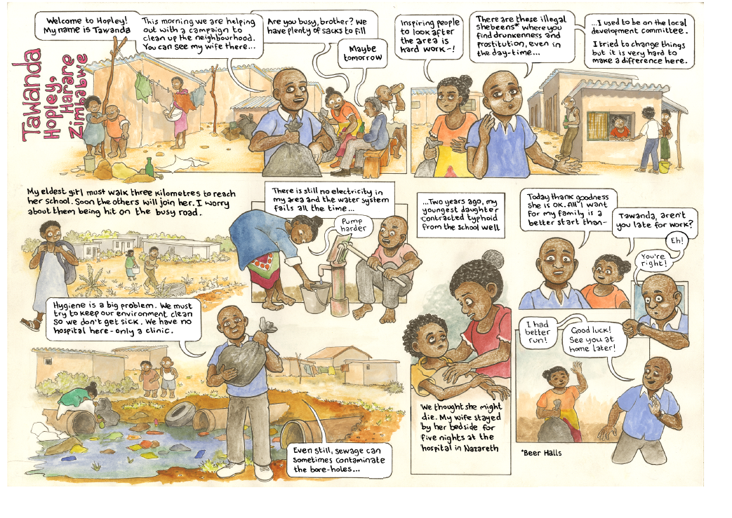
Slide title
First level bullet
  Second level
    Third level
      Fourth level
        Fifth level

Slide 3
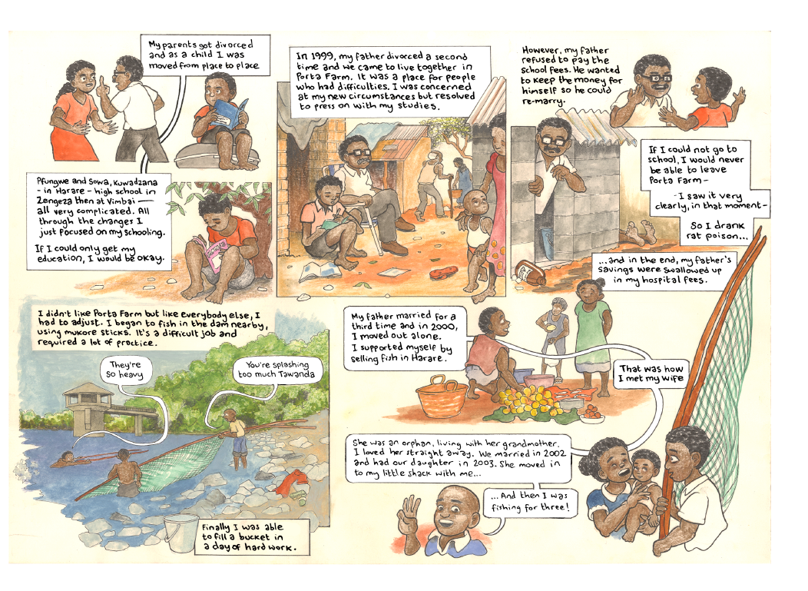
Slide title
First level bullet
  Second level
    Third level
      Fourth level
        Fifth level

Slide 4
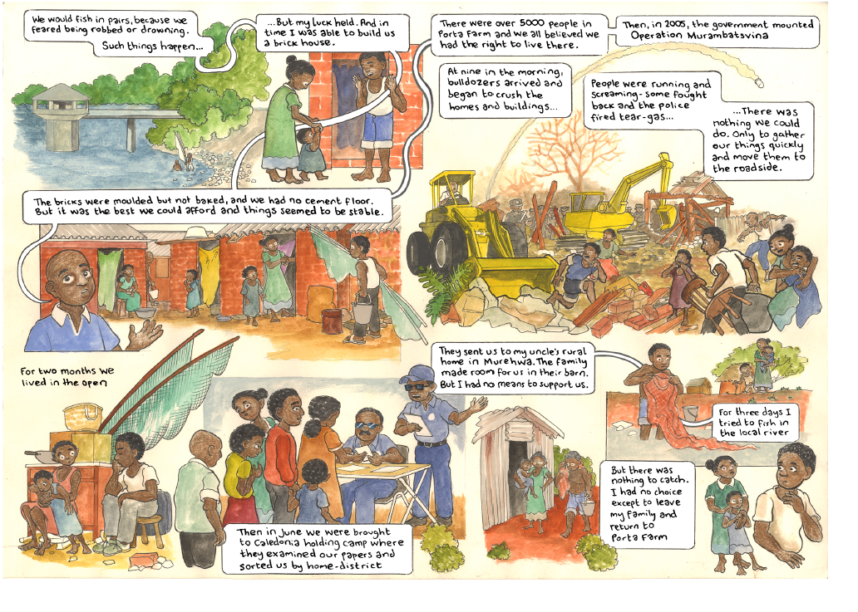
Slide title
First level bullet
  Second level
    Third level
      Fourth level
        Fifth level

Slide 5
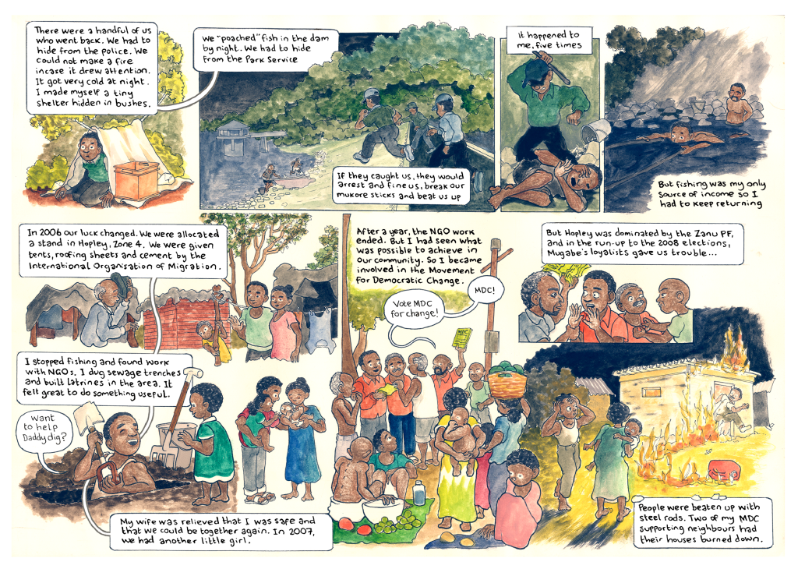
Slide title
First level bullet
  Second level
    Third level
      Fourth level
        Fifth level

Slide 6
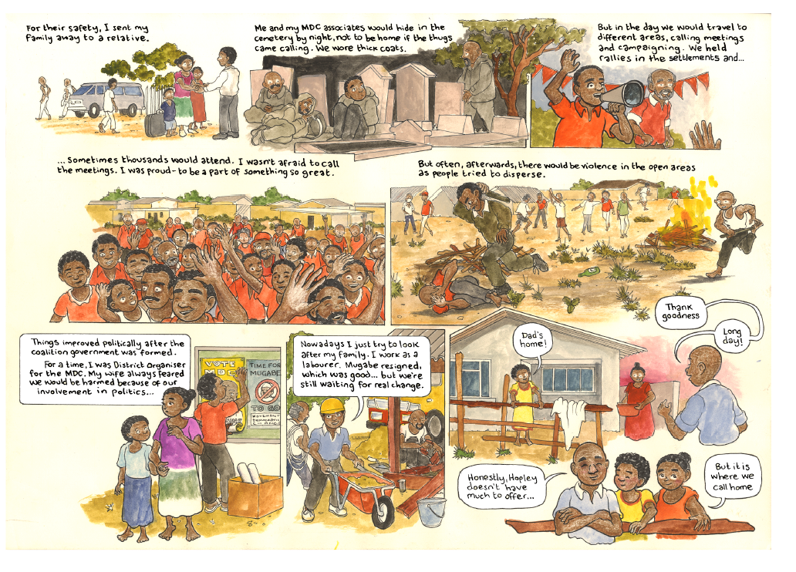
Slide title
First level bullet
  Second level
    Third level
      Fourth level
        Fifth level

Slide 7
Activity 1 – Before and after Tawanda moved
You are going to compare Tawanda’s life before and after his migration
Using the storyboards that you have just read and the information from the video complete a table like the one below.
Life before moving | Life after moving
Worked as a fisherman | Working as a labourer

Slide 8
Activity 2 – Forced evictions
If bulldozers arrived early in the morning at Porta Farm to evict Tawanda, his family and neighbours, what thoughts do you think they would have as the bulldozers arrived?
How might the people of Porta Farm describe how the eviction affected their families? Can you describe what happened and how it may have made people feel?

Slide 9
Further links
To find out more about the Migrants on the margins research in Harare visit
https://www.rgs.org/in-the-field/field-research-programme/cities/harare/

