Slide 1
Ideas for using Digimap for Schools
Darren Bailey
Schools Manager
Ordnance Survey

Slide 2
6 Different tasks
Grid reference quiz (4/6/8 figure grid reference, finding places, identifying features)
Flags game (locating countries/continents)
Who’s got the biggest football pitch (Grid reference, finding places, measuring shapes)
What time is it? (Time zones, locating countries/continents, and Maths)
Who’s got the nosiest Street? (Field work, collecting data and digital technologies)
Titanic Journey, story telling with maps!

Slide 3
Grid reference quiz;
Finding place, 4/6/8 figure grid reference, identifying features
10 sites or places around Britain, find and record the grid reference
To make it more difficult add the National Grid overlay and work out the 6-figure grid ref

Slide 4
Grid reference quiz - 10 places in the UK, can you find them and the grid reference
Place | Clue | Grid Ref easy | Grid Ref hard
Stonehenge | none
Tower of London | none
Roman Baths | Bath
York Minster | York
Welsh Assembly | Cardiff Bay
Canterbury Cathedral | Canterbury
Warwick Castle | Warwick
Edinburgh Castle | Old Town
Chester Zoo | Look north to Upton
Eden Project | North East from St Austell

Slide 5
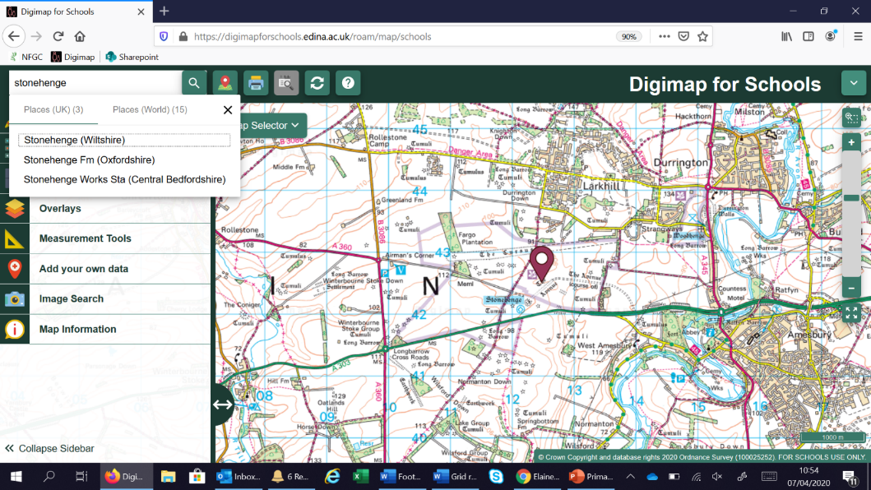

Slide 6
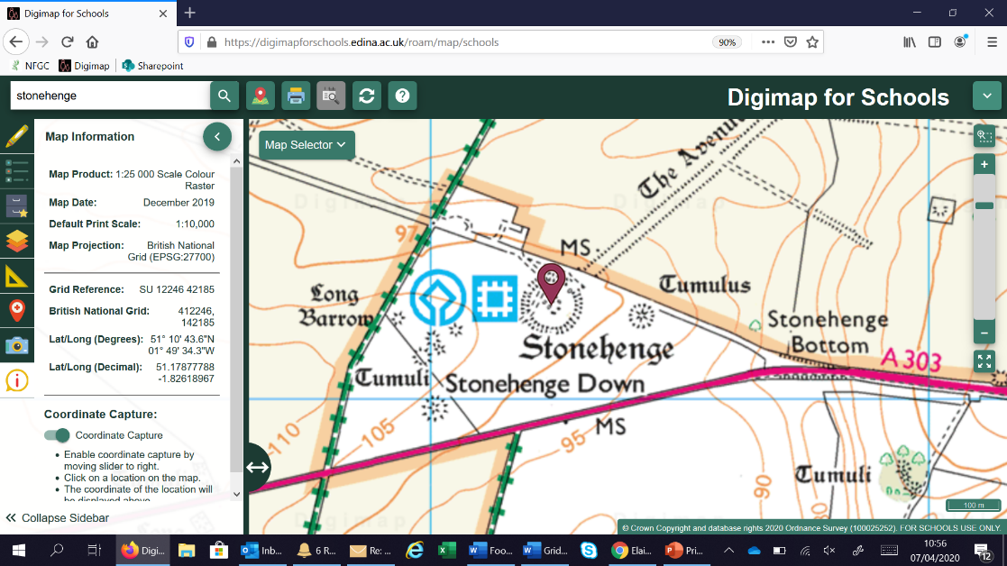


Slide 7
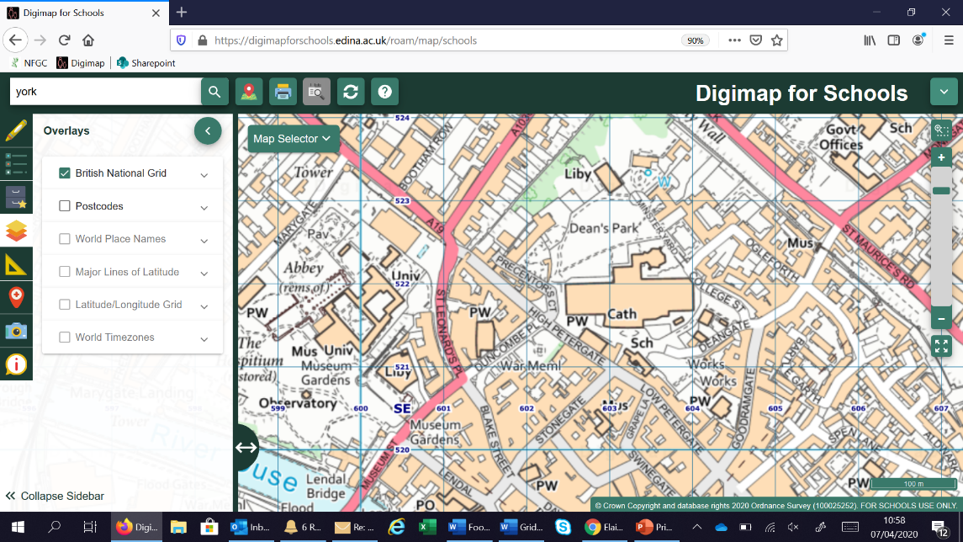





Slide 8
Flags Game;
Here are ten flags from around the world can you place them on the map? Clues can be the country name or the continent it’s found on.
Jpegs for each flag can be downloaded here - https://www.craig-edmonds.com/flags-of-the-world/
Create a folder (perhaps on the desktop) and save your 10 flags into this.
You can either keep the country name attached, or to make it more difficult rename the images to flags 1-10

Slide 9
Brazil
Canada
Ivory Coast
Ecuador
France
Greece
New Zealand
Pakistan
South Africa
Sri Lanka

Slide 10
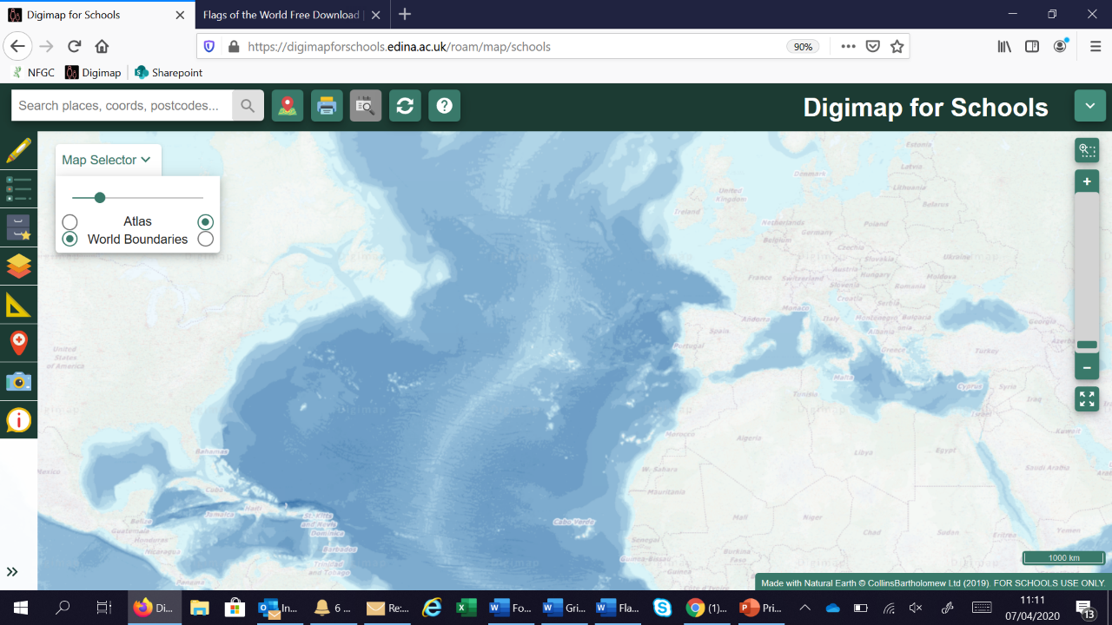


Slide 11
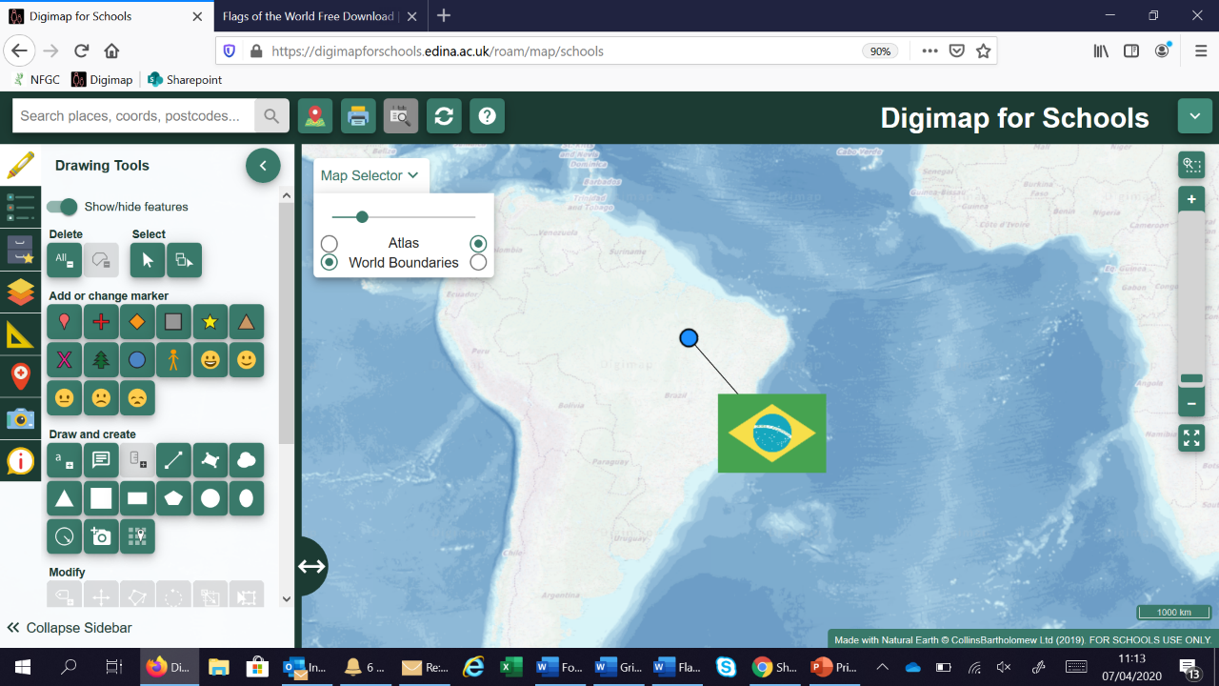


Slide 12
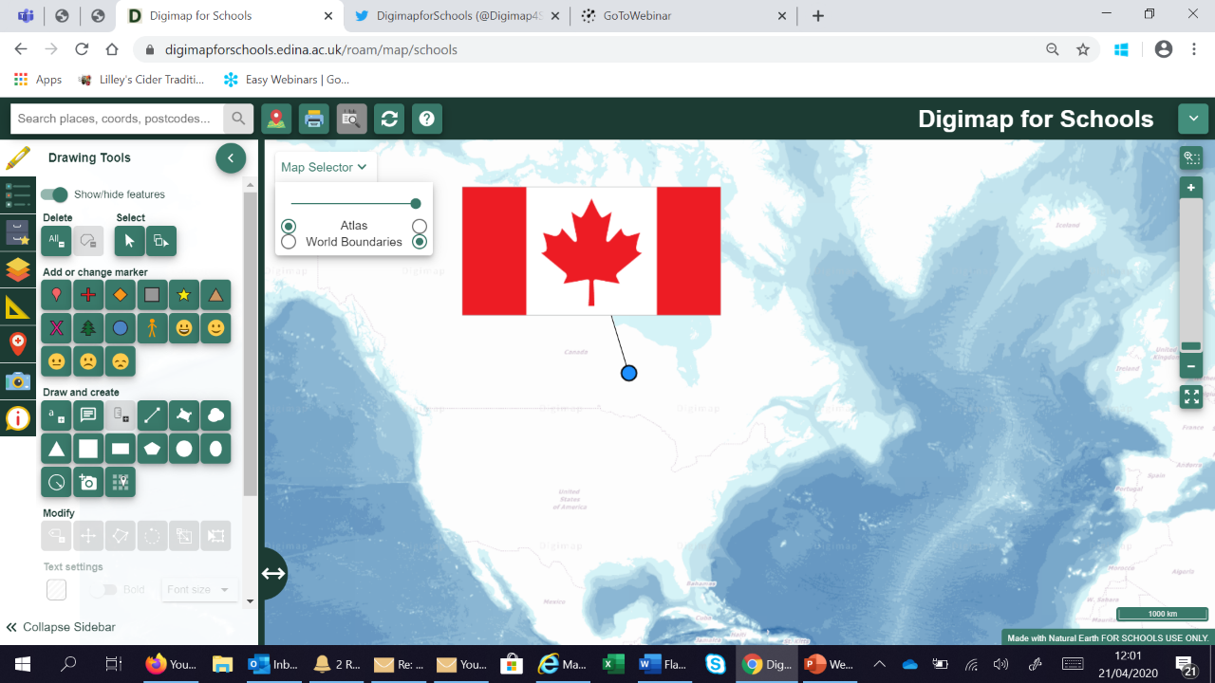

Slide 13
Who’s got the biggest football pitch?
Find all 20 premier league grounds and measure the playing area size
Extra – Add the grid references as well.
Can be tailored to just the teams near you.

Slide 14
Team | Postcode | Size of playing area | Grid Ref for Ground
Arsenal | N7 7AJ
Aston Villa | B6 6HE
Brighton | BN1 9BL
Bournemouth | BH7 7AF
Chelsea | SW6 1HS
Crystal Palace | SE25 6PU
Burnley | BB10 4BX
Everton | L4 4EL
Leicester | LE2 7FL
Liverpool | L4 0TH
Manchester City | M11 3FF
Manchester Utd | M16 0RA
Newcastle Utd | NE1 4ST
Norwich City | NR1 1JE
Sheffield Utd | S2 4SU
Southampton | SO14 5FP
Tottenham | N17 0BX
Watford | WD18 0ER
West Ham Utd | E20 2ST
Wolverhampton Wanderers | WV1 4QR

Slide 15
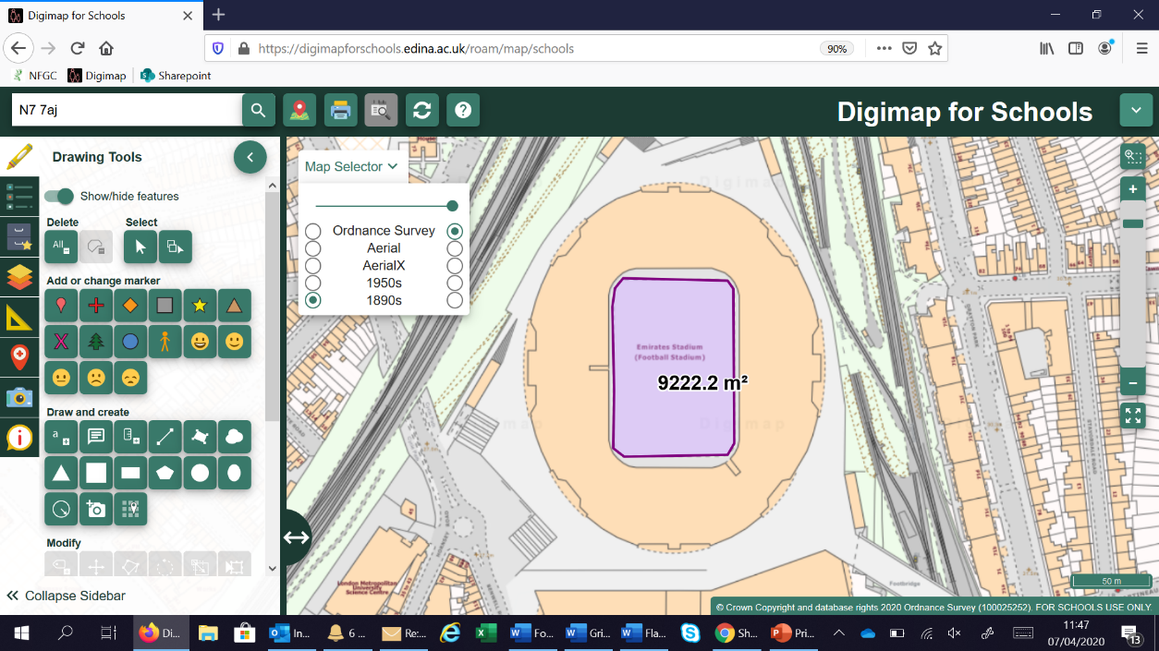



Slide 16
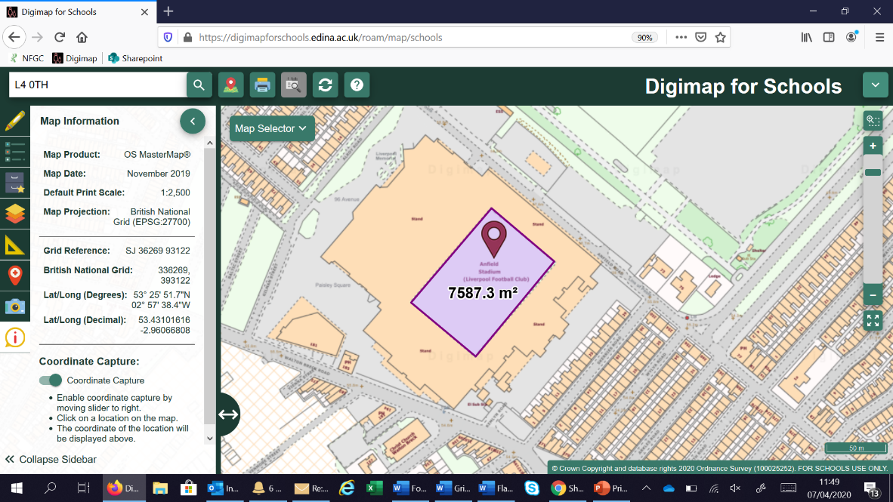



Slide 17
What time is it?
Using the time zone layer, can we work out the times in different places.
You can start with easy ones and get progressively harder. Covers; place, location, time zones and maths!
Extra; measure the distance between places.

Slide 19
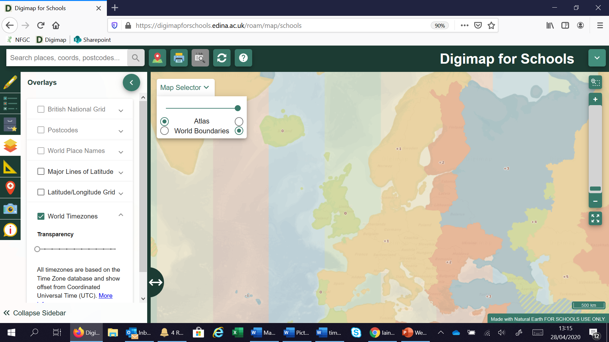


Slide 20
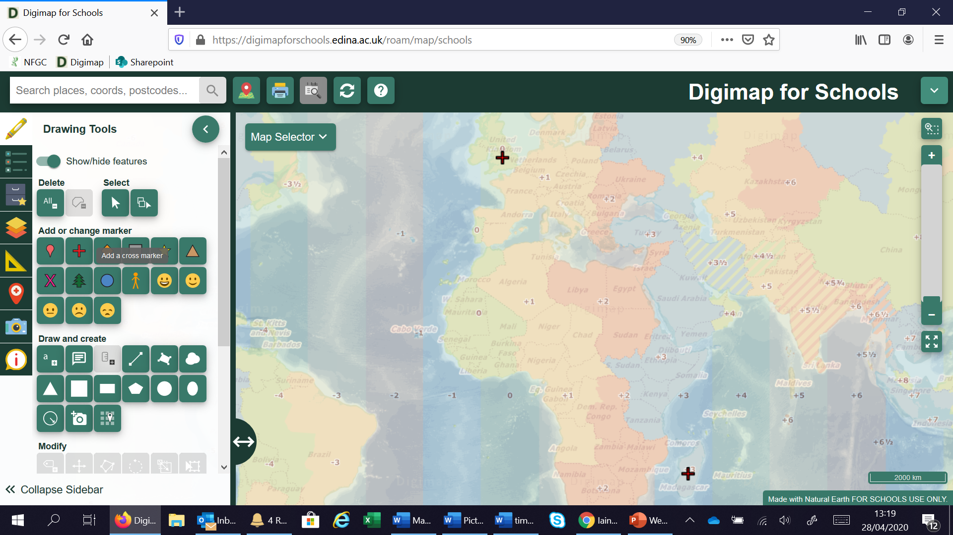

Slide 21
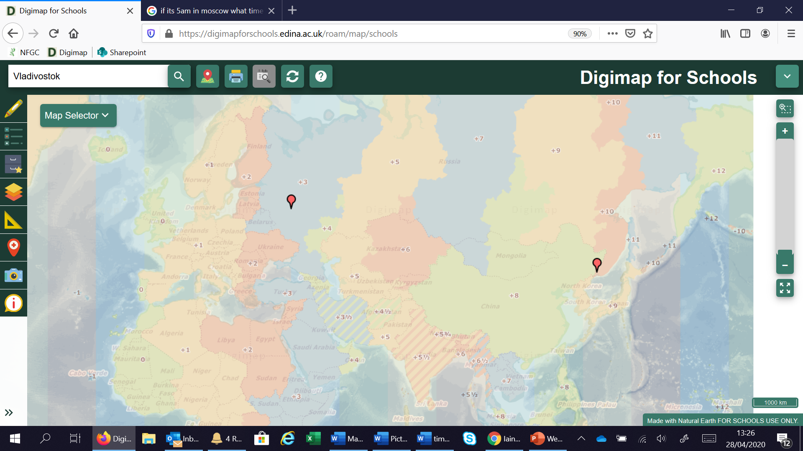

Slide 22
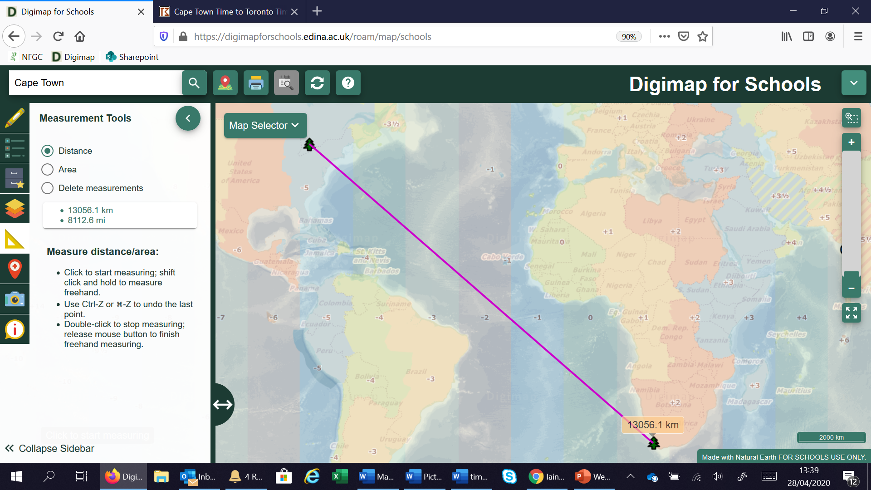

Slide 23
Who’s got the noisiest street?
Using location and decibel apps, where is the nosiest place
Fieldwork, place and collecting data

Slide 24
You will need;
A smart phone
Two apps; Decibel X and either Gridpoint GB (iphone) or OS Locate (Android)
Excel to record your data.

Slide 25
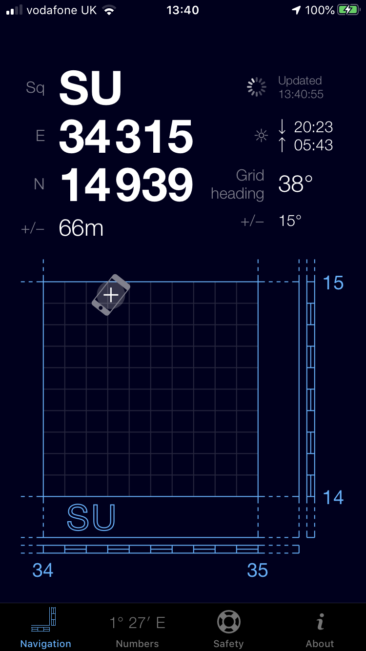
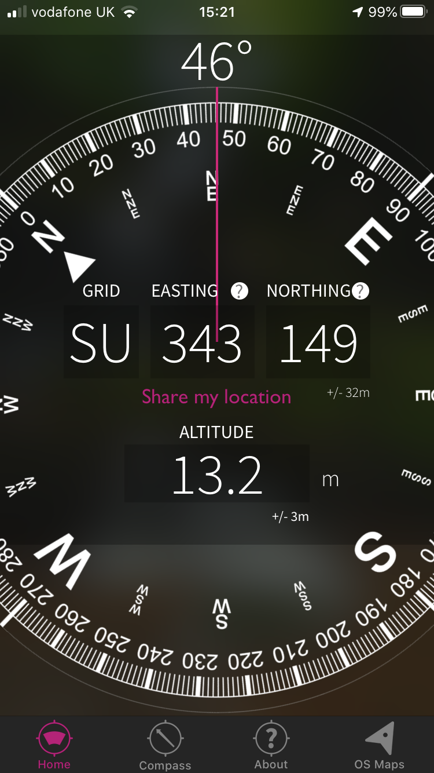
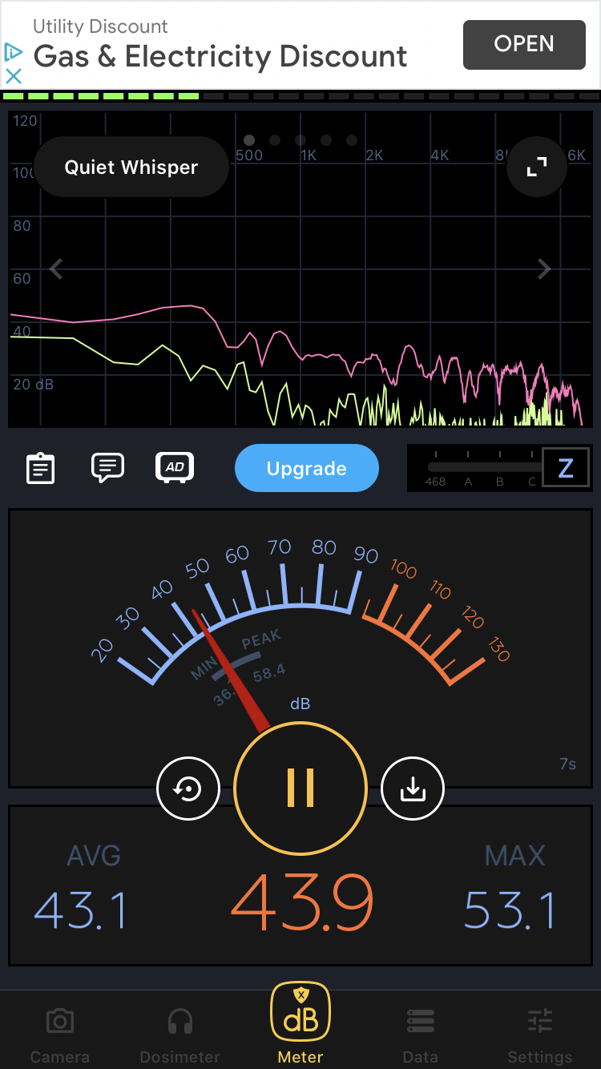
Gridpoint GB
OS Locate
Decibel X

Slide 26
Each pupil will record their location using Gridpoint GB or OS Locate
And the decibel level
By taking a screen shot of each one, they record both pieces of data
You can collate all the data together in a spreadsheet and upload it in to Digimap for Schools

Slide 27
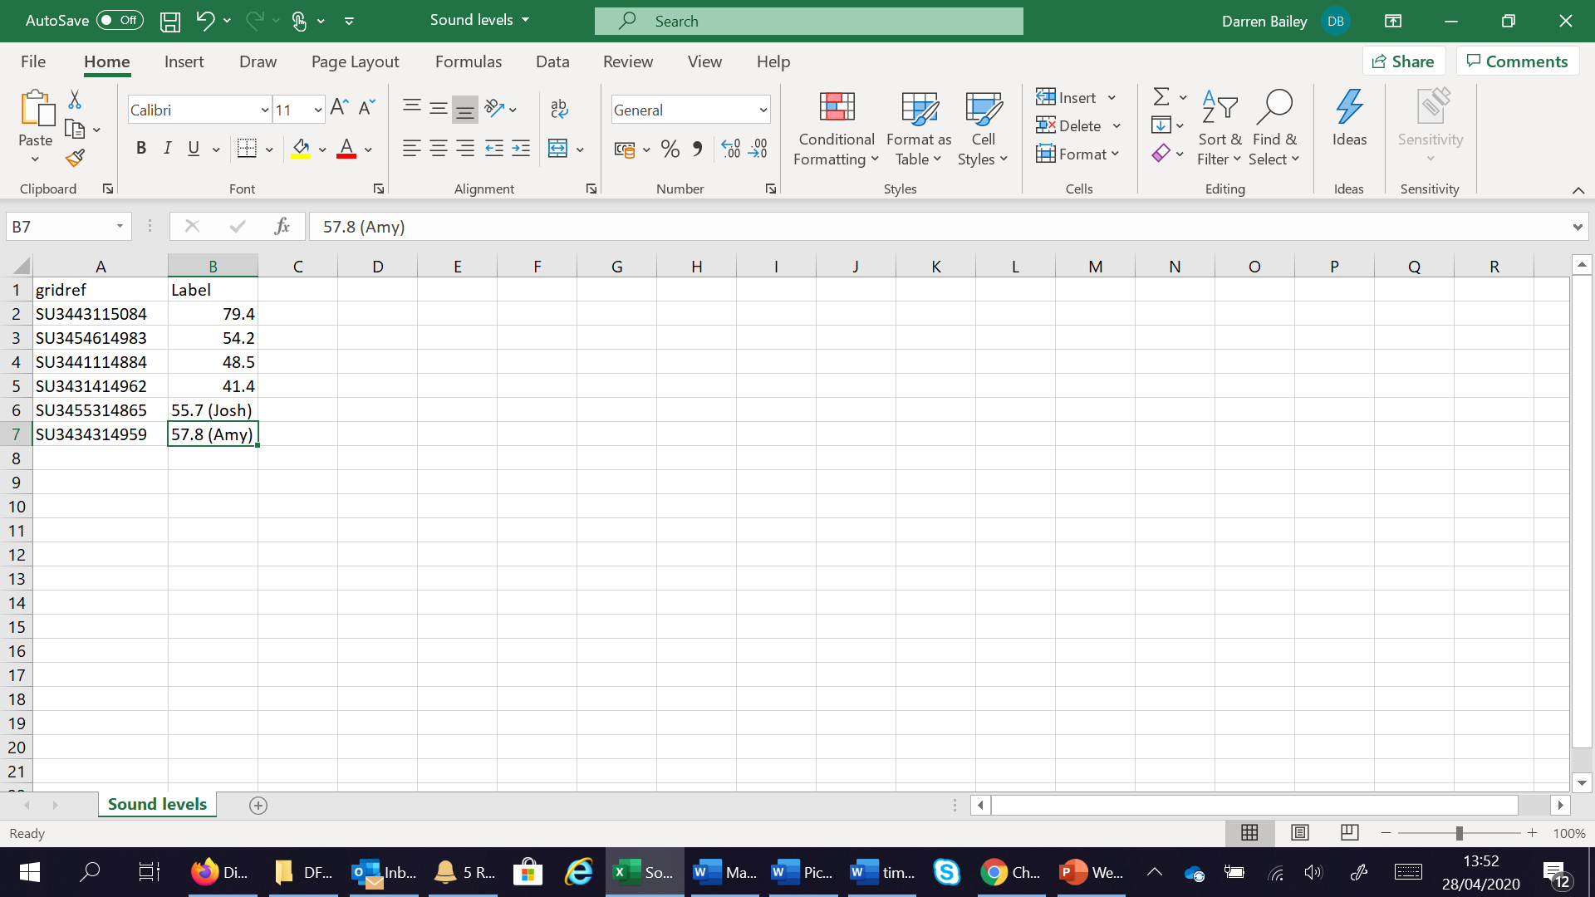

Slide 28

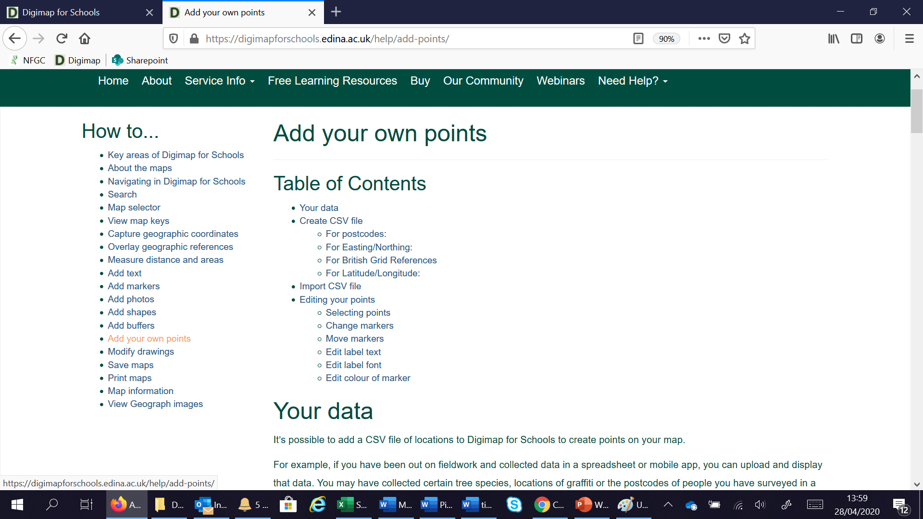

IMPORTANT INFORMATION!
Format of location field– Click the ? for the help files
Your spreadsheet must be saved as .CSV file

Slide 29
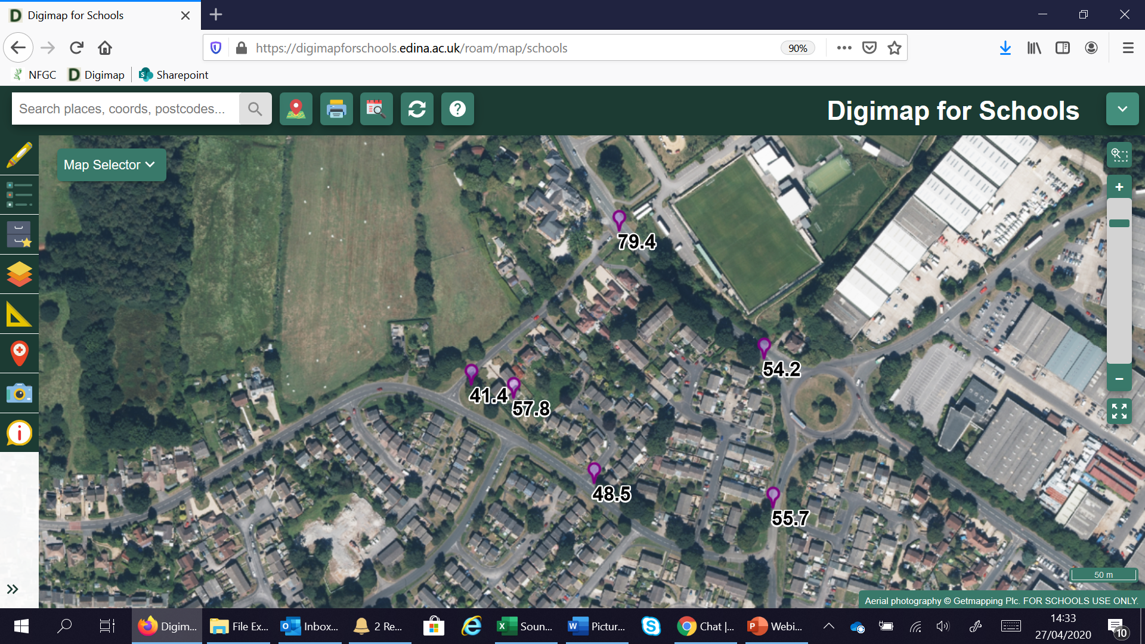

Slide 30
Other things you could record (could be around the school site);
Temperature
Wind Speed
Rain fall
Height

Slide 31
Titanic Journey, story telling with maps
Using world maps, Lat and Long, line drawing tool, text boxes and measurement

Slide 32
