Slide 1
Lesson seven: Assessment How much do you know?

Slide 2
UK Knowledge: Part one
Carefully examine the following images.
Describe what you see
Suggest where in the UK the photograph may have been taken
Explain the human or physical processes leading to its creation
Put forward ideas on the interdependence between physical and human features

Slide 3
What, where, how?
Notes:
Loch Torridon, Wester Ross, from a negative, Scotland © Robert J Heath, Flickr

Slide 4
What, where, how?
Notes:
Pixabay: Lulworth Cove Ocean Of The Sea Country Bay Dorset, diego_torres. Accessible at: https://pixabay.com/en/lulworth-cove-ocean-of-the-sea-820136/

Slide 5
What, where, how
Notes:
The Cube Building Architecture Façade Design © glidagida, pixabay (Birmingham)

Slide 6
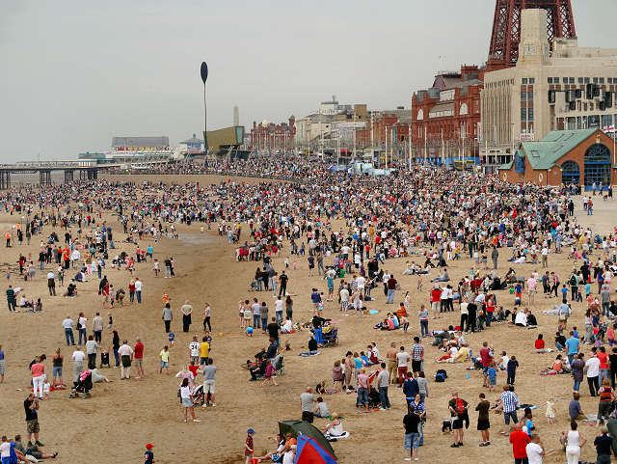
What, where, how?
Notes:
Crowds on Blackpool Beach © David Dixon Source: geograph

Slide 7
What, where, how
Notes:
The Notting Hill Carnival © Nora Julianna Kovacs, Flickr (London)

Slide 8
Part two: Just a Minute Game
Rules for UK ‘Just A Minute’ Game
Pupils take it in turns to be one of four panellists who sit on desks at the front of the classroom. The teacher or another child can act as chairperson.
The four panellists are challenged to speak for one minute on a given subject without "repetition, hesitation, or deviation“
“Repetition" means the repetition of any word or phrase, although challenges based upon very common words such as "and" are generally rejected.
"Hesitation" is watched very strictly and a momentary pause can give rise to a successful challenge.
"Deviation" means deviating from the subject, but it has also been interpreted as "deviating from the English language as we know it", "deviation from grammar as we understand it", deviating from the truth, and sometimes even logic, although use of imagination and creativity are encouraged.
A panellist scores a point for making a correct challenge against whoever is speaking, while the speaker gets a point if the challenge is deemed incorrect
If a witty interjection amuses the ‘audience’, both the challenger and speaker may gain a point, at the discretion of the chair.
A player who makes a correct challenge takes over the subject for the remainder of the minute, or, until he or she is correctly challenged.
A panellist also scores a point if they are the person speaking when the 60 seconds expires. An extra point is awarded when a panellist speaks for the entire minute without being challenged.

Slide 9
Just a Minute game: Possible topics
Things to consider when climbing Snowdon
London from the top of a double-decker bus
Why the weather is important
My favourite UK food product
Football Team nicknames
Birmingham old and new
Multi-cultural London

