Slide 1
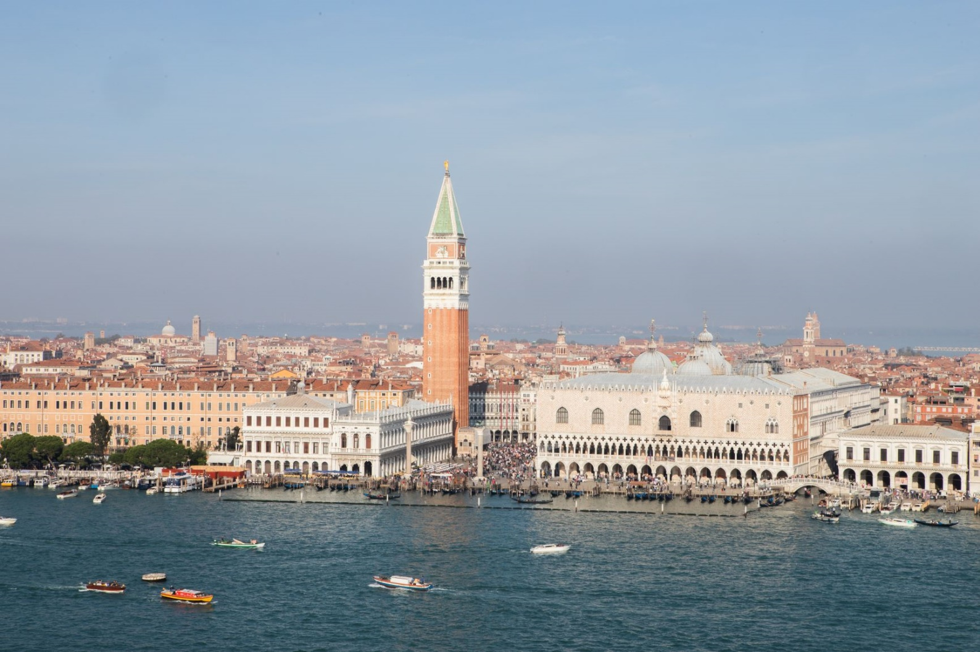
Venice as a changing place: old concerns and new challenges
lesson 4: part 2 governance and economic and challenges
View of St Mark’s Campanile and the Doge’s Palace © photo Jasper Sodha

Slide 2
Governance challenges
As a result of decades of conflicts of interest between the needs of the historic city and the mainland parts of the Comune of Venice, five independence referendums have taken place in the last 40 years seeking to split the municipality.
This article in The Week offers a summary of some arguments for and against splitting the historic city’s municipal governance from mainland Mestre: https://www.theweek.co.uk/104165/why-venice-is-fighting-for-autonomy
The most recent referendum was held on 1 December 2019. Despite 66% of those who voted being for the splitting of the municipality, a low turn out (22% of eligible voters across the Comune, 33% of voters in the historic city) meant that the result was considered invalid. The articles below report on the referendum.
https://www.ft.com/content/2c045b78-1514-11ea-9ee4-11f260415385
https://www.theguardian.com/world/2019/dec/01/venice-referendum-autonomy-independence-mestre-depopulation
This article below details the arguments for separating the municipal governance of the historic city from Mestre and Marghera.
https://weareherevenice.org/future-venice-depends-referendum/

Slide 3
Economic issues and challenges
Governance and economic issues are closely intertwined, and economic forces are often at the root of conflicts of interest that play out at different levels of governance.
The next set of slides looks at a range of economic factors influencing the historic city so that the conflicts between different stakeholders can be better understood.
The slides finish with some proposed solutions for a more sustainable economic future.

Slide 4
An economy reliant on tourism
Tourism is the main contributor to the economy of the historic city (the value to the economy being approximately 2 billion euros annually).
It is the most visited Italian city after Rome.
The revenue from tourism cannot be easily replaced, and tourism provides a lot of employment.
Over 25 million tourists per year visit Venice, but most do not stay overnight.
Most (about 14 million) are day trippers who spend relatively little money but cause over-crowding and problems for waste management.
On average, there are over 60,000 tourists in Venice daily, more than the resident population of the historic city.
Problems resulting from mass tourism are described in this article:
https://www.theguardian.com/cities/2019/apr/30/sinking-city-how-venice-is-managing-europes-worst-tourism-crisis

Slide 5
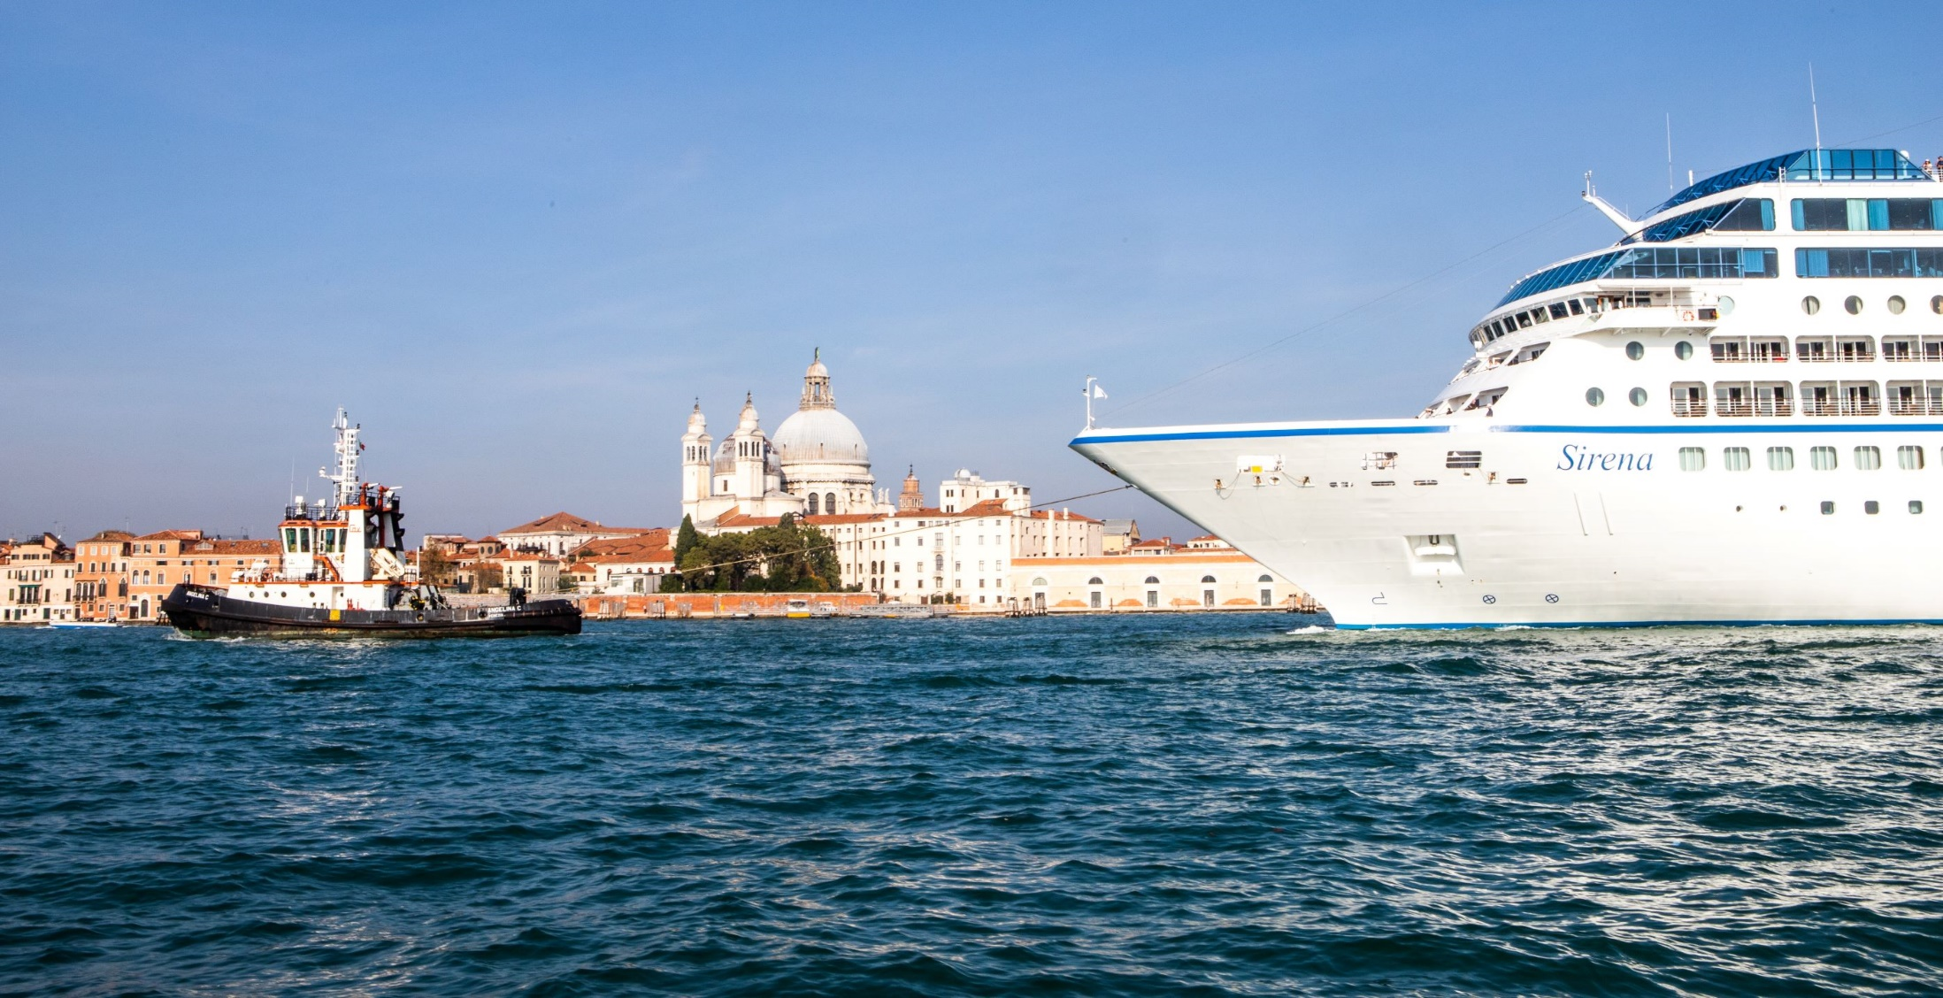
Economic issues and challenges: cruise ships
Jasper Sodha: cruise ship in the Giudecca – a relatively small one!
From April to October, on average cruise ships bring over 30,000 people into the city each day.
The cruise ship industry generates over 7,000 local jobs, and contributes about 400 million euros annually to Venice’s economy (2012 figure).
In 2018 there were 1.56 million cruise ship passengers stopping in Venice. Most ships have over 3,000 passengers.
Venice is the third largest cruise port in Europe.

Slide 6
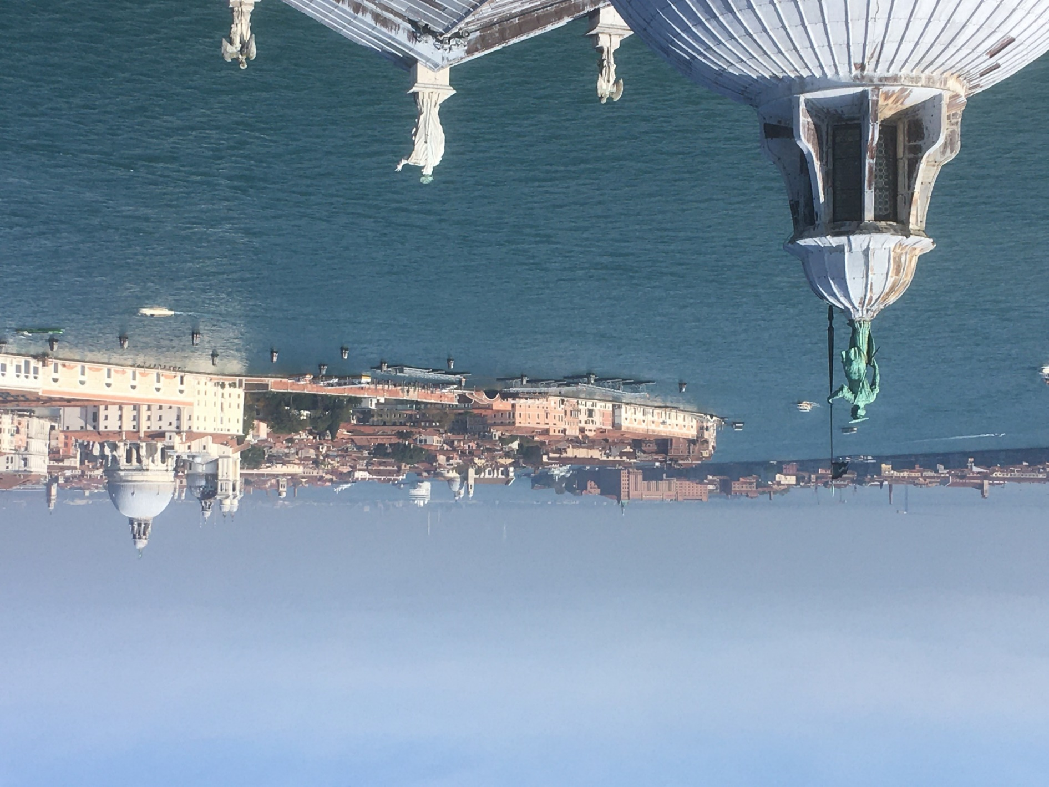
Industrial area of Marghera
on mainland to the west
cruise ship
The Giudecca (current route for cruise ships)
Photo by DEA
The largest cruise ships over 96,000 tons do not enter the Giudecca, but the ships beneath this limit still dwarf the surrounding buildings.

Slide 7
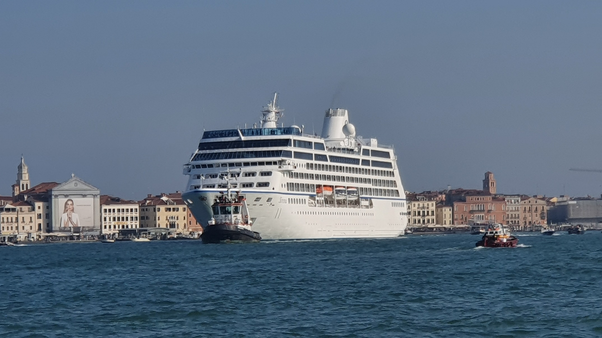
A cruise ship in the Giudecca
Hamza Shaukat

Slide 8
Impacts of the cruise ship industry
Problems surrounding cruise ships:
Congestion, especially in certain ‘honey pot’ areas of Venice (such as St Mark’s Square and the Rialto Bridge) as passengers are time limited and so gravitate to the famous locations.
Cruise ship passengers often do not spend much money in the city itself (e.g. accommodation and food is provided on the ship).
Air pollution from engine exhaust (it’s been estimated that each ship pollutes an equivalent of 14,000 cars), erosion of banks and bed of lagoon due to wake and displacement of water beneath the ships.
Detract from the aesthetics of the city due to their size.
Safety concerns, for example the accident in June 2019 of the cruise ship MSC Opera, weighing 65,000 tonnes, watch this SkyNews videoclip: https://www.youtube.com/watch?v=MmQbEgUVz40

Slide 9
Economic impacts of flooding
Short term impacts:
Cost of repairs to properties and infrastructure (the November 2019 floods are estimated to have caused about 1 billion euros of damage).
Lost revenue due to cancellations (e.g. hotel bookings dropped by about 40% in the immediate aftermath of the November 2019 floods).
See this link for video of the nature and extent of the November 2019 floods: https://www.youtube.com/watch?v=hjfHb4huiGo
Long term impacts:
A continuing decline of the resident population which, in turn, will lead to a further increase of shops and services catering for tourists at the expense of the local community.
Cumulative damage to buildings due to water and salt ingress, with potentially very high restoration costs in the future. Sea level rise will exacerbate this problem, unless flooding can be prevented (see slide 10).

Slide 10
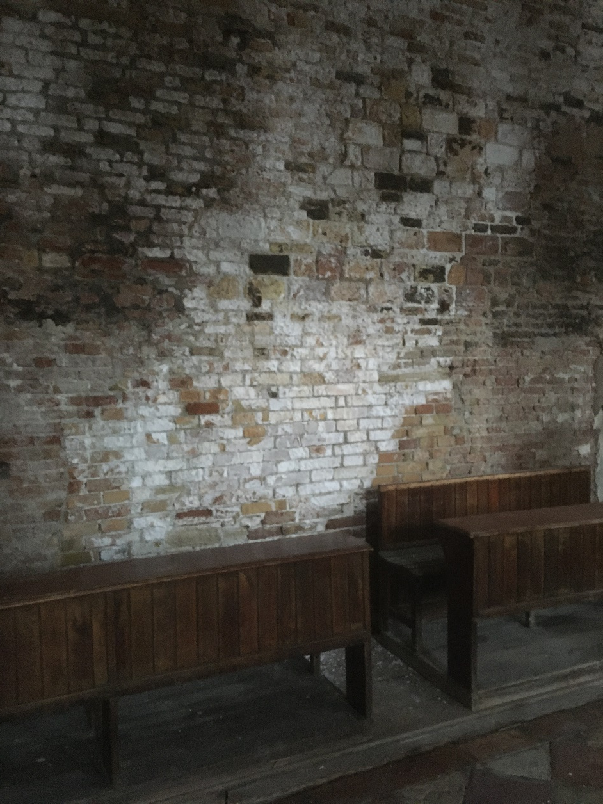
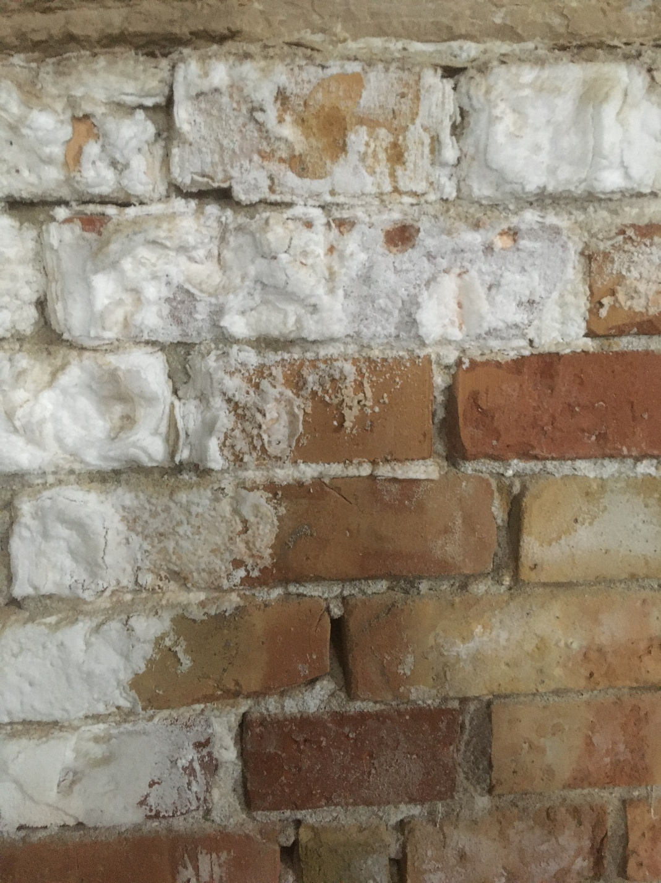
Salt efflorescence on an interior wall in Venice.
DEA
When sea water makes contact with porous material (such as bricks) capillary action draws the moisture upwards, and salts precipitating out of solution inside bricks weaken them, thereby undermining the structural integrity of buildings.
DEA

Slide 11
Economic costs with the MOSE scheme
The MOSE scheme is a large tidal barrier project (conceived in the 1980s, with work starting in 2003) with a total cost of over 5 billion euros. Sets of gates at the three inlets to the Lagoon of Venice (Lido, Malamocco, Chioggia) are designed to be closed to the Adriatic Sea when a tidal level of +110cm is forecast (which would otherwise flood about 15% of the historic city).
There are many problems with the scheme:
It is over budget (by about 3 times original cost estimate) and very delayed (originally planned for 2011, now expected to be complete by the end of 2021)
There was a corruption scandal in 2014 associated with it
There are design flaws
Once complete, maintenance of the structures could cost about 80 million euros a year
See the links below for more information about the scheme and its problems:
https://www.youtube.com/watch?v=O2alRTLibvo&feature=youtu.be
https://www.theguardian.com/environment/2019/dec/10/venice-floods-sea-level-rise-mose-project

Slide 12
A way of raising more money
The high numbers of tourists put a lot of stress on the historic city’s infrastructure (especially for cleaning and waste management).
Starting in 2020, an entry fee of up to 10 euros, depending on time of year and date, will need to be paid for all day visitors (over the age of six).
Visitors who stay the night in Venice will be exempt from this, as there is already a city tax added to hotel charges.
This new fee will generate around 50 million euros of additional funds.
https://uk.reuters.com/article/uk-italy-venice/italys-venice-to-charge-admission-fees-for-tourists-idUKKCN1QG1F4

Slide 13
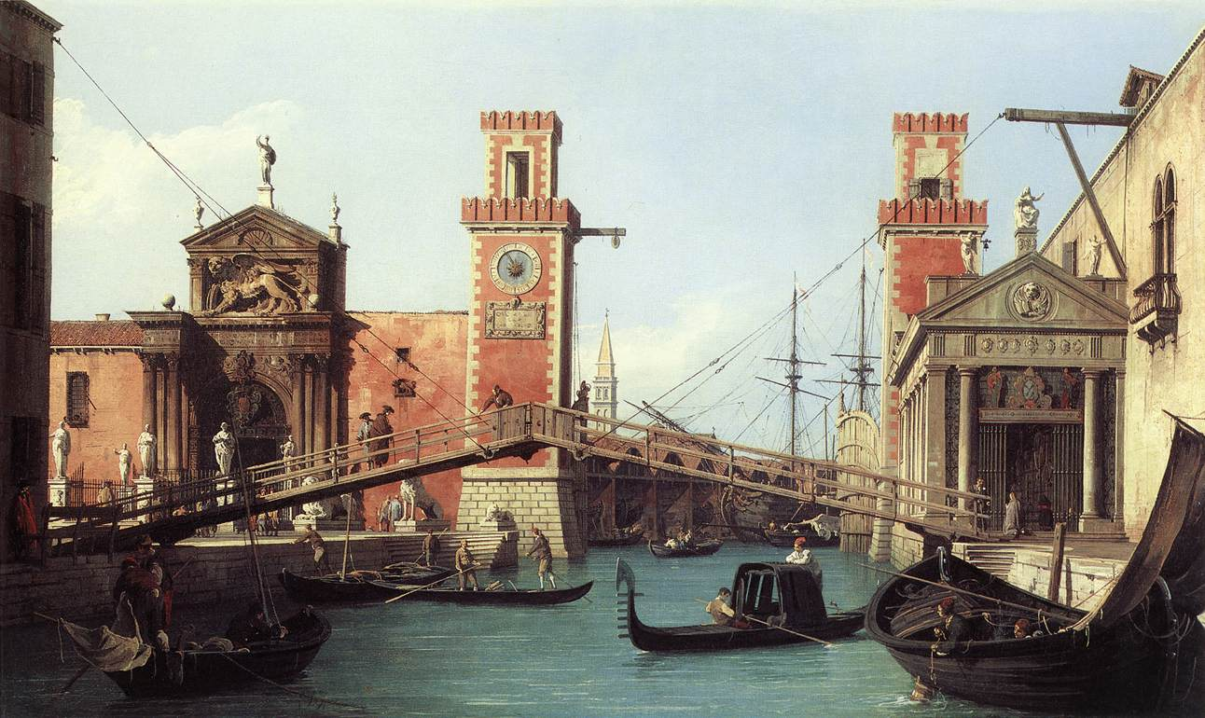
Some possible solutions to diversify the economy
Venice’s reliance on tourism for most of its revenue is relatively recent in the city’s long history. As illustrated in this painting by Canaletto, the city was previously a major centre for both manufacturing (e.g. ship building and glass) and trade.
By Canaletto - Web Gallery of Art: Image Info about artwork Transferred from en.wikipedia to Commons. ([1]) —Dacxjo 17:47, 1 March 2006 (UTC), Public Domain, https://commons.wikimedia.org/w/index.php?curid=606582

Slide 14
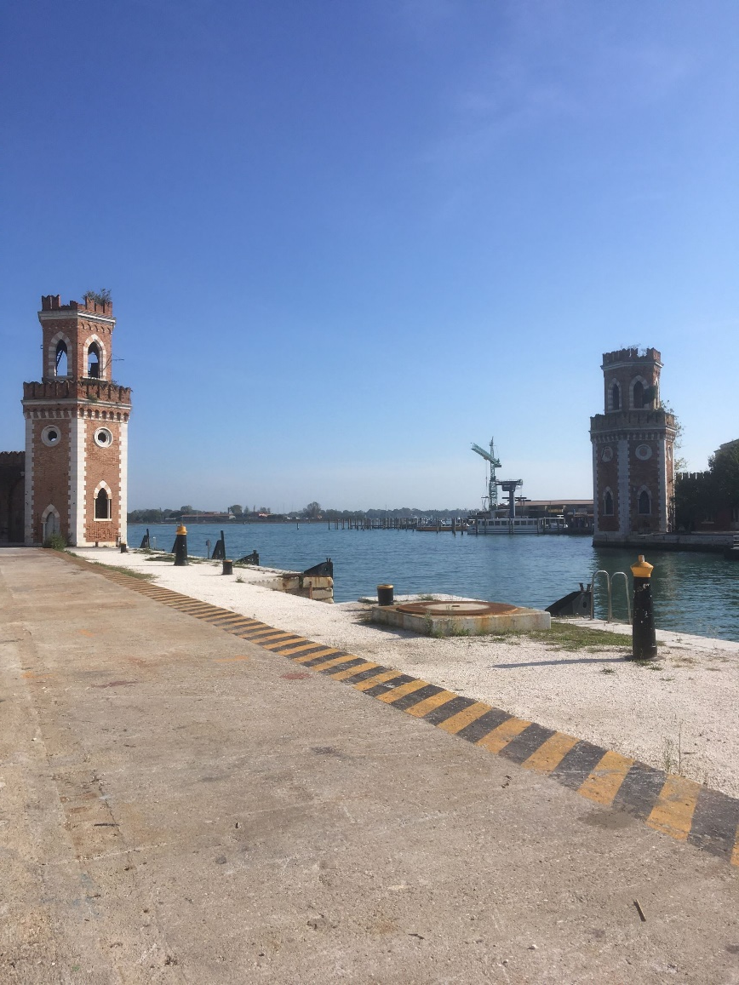
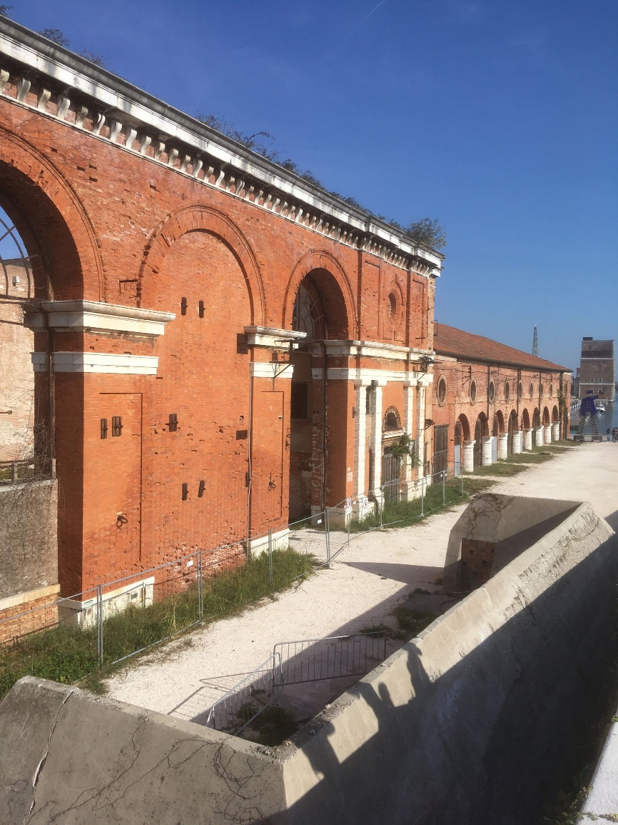
There are areas of the historic city, such as the Arsenale, that are less frequented and could be regenerated.
DEA
DEA
Photos of the Arsenale area, which was previously Venice’s shipyard and a hub of industrial activity. The area has potential for more local accommodation, light industries, offices, galleries, and exhibits.

Slide 15
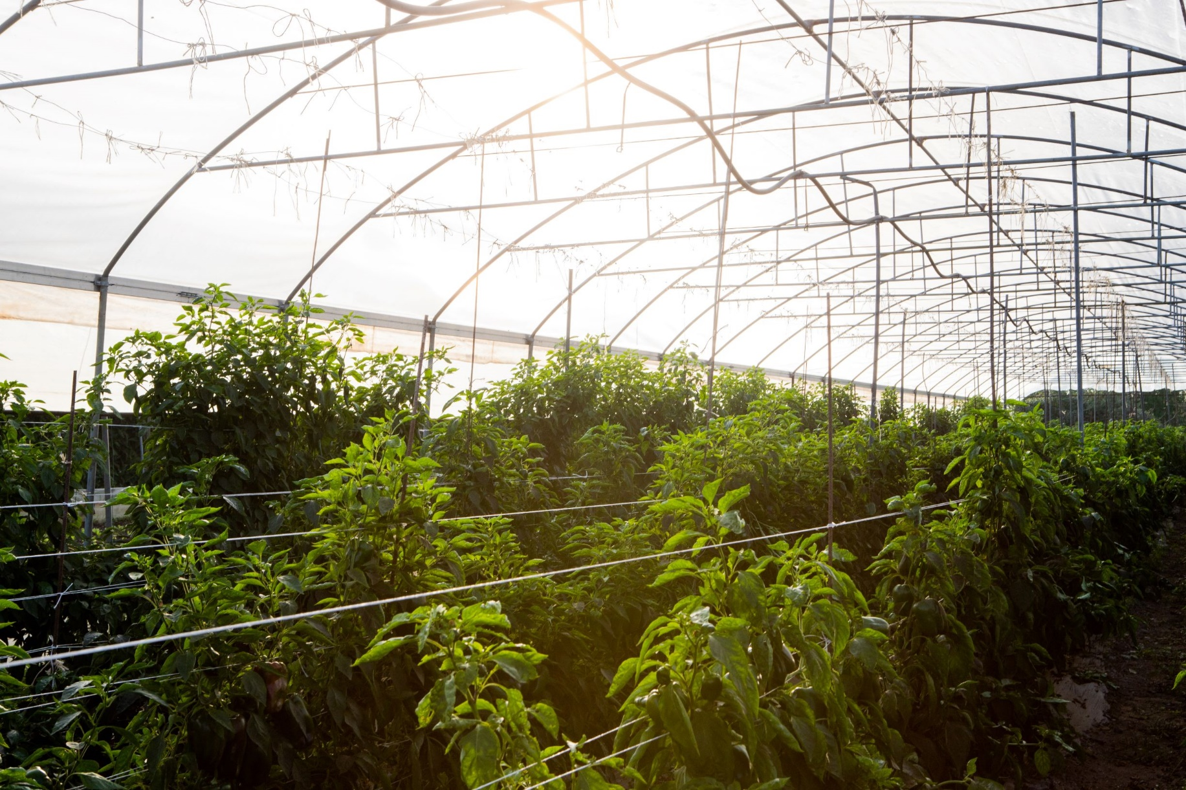
Local activities, such as fishing and farming, could be supported more by government, residents, and tourists.
Jasper Sodha
Photos of horticulture at a farm on Sant’Erasmo island. The farm has contracts to supply hundreds of families and restaurants with local produce.

Slide 16
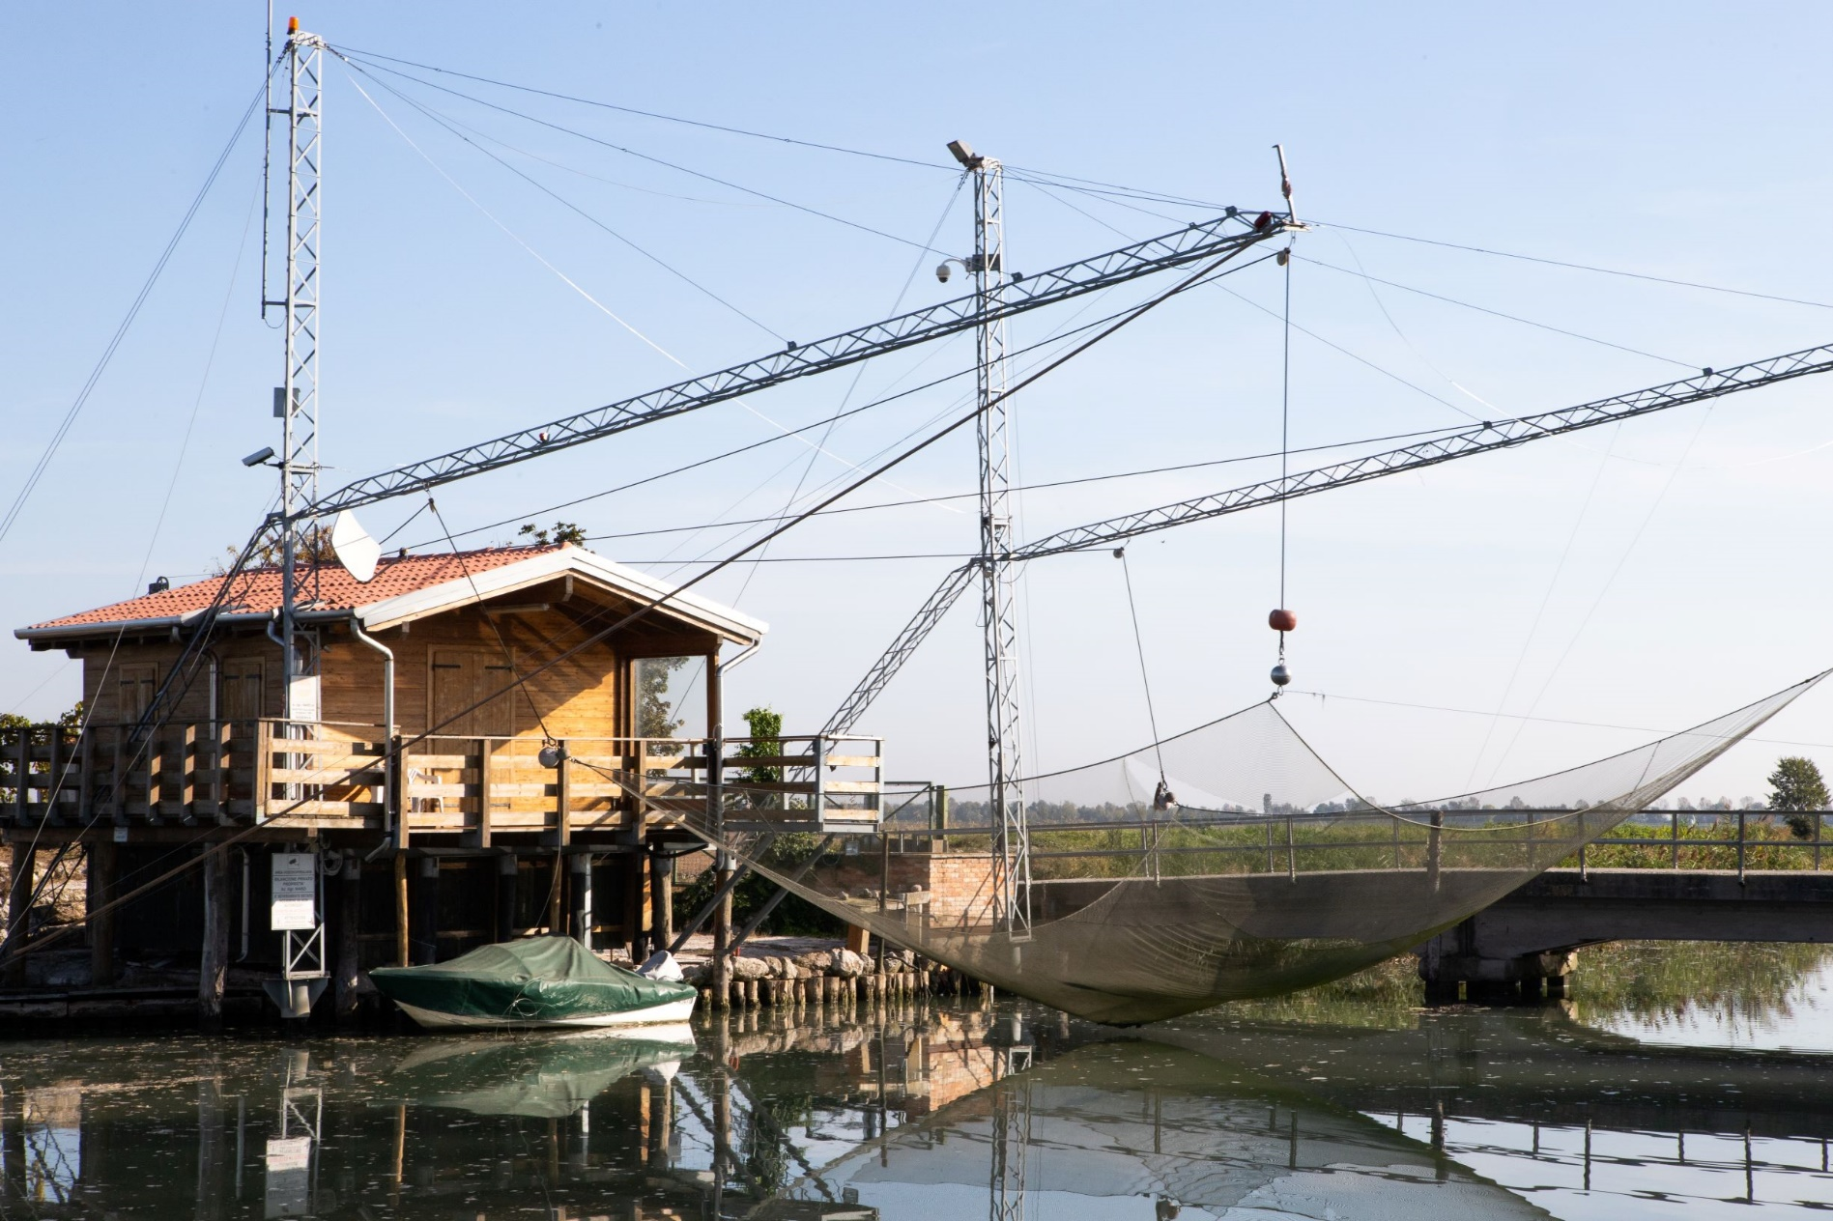
There is potential for fishing in the local area, but this is challenged by shipping and by deterioration of the ecological health of the lagoon.
Jasper Sodha
A system for netting fish.

Slide 17
Some traditional Venetian products and shops remain that provide skilled employment to Venetians.
Venezia Autentica is an organisation that promotes local shops and artisans (https://veneziaautentica.com/).
For example, the Tragicomica mask shop both sells traditionally made Venetian masks and also offers workshops for people to decorate their own.
Bookbinding, printing, boat building, and glass making are other traditional Venetian activities still present in the city.
The article below discusses the problem of traditional services and activities being crowded out by lower order goods and services geared towards mass tourism, such as cheap souvenir shops and fast-food.
https://www.theglobeandmail.com/world/article-venices-identity-is-threatened-by-mass-tourism-and-flooding-the-city/

Slide 18
Accommodation issues
Property owners can earn much more by renting to tourists as opposed to locals, and online platforms such as Airbnb and HomeAway have made this easier than ever before.
There are almost 9,000 Airbnb listings in Venice, and this is reducing available accommodation for locals and making long-term renting and home ownership less affordable.
Airbnb has had a major impact on many other city destinations, notably Athens, Florence, Barcelona, and Lisbon as described in this article.
https://www.ft.com/content/2fe06a7c-cb2a-11e9-af46-b09e8bfe60c0
Recent rules in Venice to control the growth of tourist accommodation at the expense of locals include:
A ban on new hotel developments (unless they offer a public service)
New regulations, such as the requirement to install a septic tank beneath accommodation offered for short-term rental (a financial disincentive)
Fairbnb.coop (which serves Venice and some other cities) promotes sustainable tourism and enables tourists to homeshare in cities while also contributing to projects that benefit the local community. https://fairbnb.coop/
This article goes into further detail about the economic and social impacts of mass tourism in Venice: https://edition.cnn.com/travel/article/venice-overtourism-situation-flooding/index.html

