Slide 1
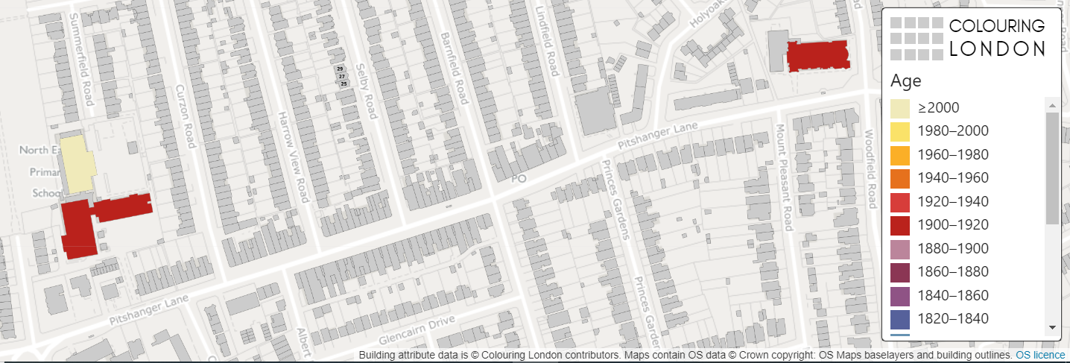
Colouring London
My local area
KS2
Lesson ideas

Slide 2
Colouring London
Colouring London aims to collect information on every building in London, to help make the city more sustainable.
It provides information about your local area
https://colouringlondon.org/

Slide 3
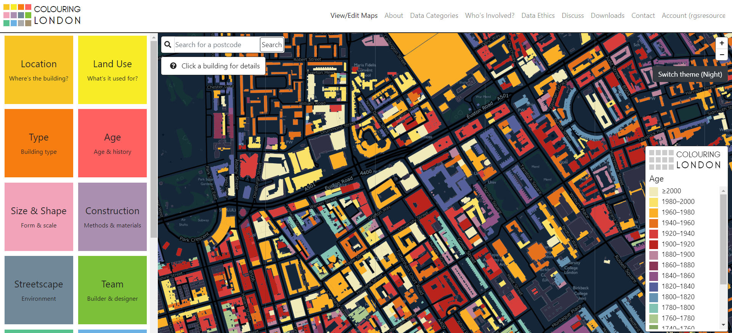
Colouring London
The Colouring London team would like to colour in every building in London and they need your help.

Slide 4
What is GIS?
GIS stands for Geographical Information Systems
It allows us to collect, store, process and display different categories of information linked to places on maps.
GIS can be used to identify patterns and can tell us about what a place is like.
In fact, you have probably used GIS without realising it, such as searching where you live in Google Maps.
You can find out more by visiting https://www.ordnancesurvey.co.uk/mapzone/gis-zone

Slide 5
What information should I collect?
Thinking hats task
Divide into groups of 6 to discuss the following two questions:
What does sustainability mean?
What information could you collect about a building that might tell us about how sustainable it is?

Slide 6
The Thinking Hats
 | White Hat | Data and information
 | Red Hat | Feelings and intuition
 | Yellow Hat | Positive view
 | Black Hat | Critical approach
 | Green Hat | Creative thinking
 | Blue Hat | Summaries and conclusions
Notes:
Based on Edward de Bono Six Thinking Hats published 1985

Slide 7
Discuss
Write your class ideas into the bubble below

Slide 8
Review
Suggestions
How old the building?
Is the building empty/unoccupied?
What is the building used for?
Is the building made of bricks?
How many windows does the building have?

Slide 9
What information should you collect?
Colouring London would like to collect
Location
Land use
Type
Age
Size & Shape
Construction
Streetscape
Team
https://www.pages.colouring.london/buildingcategories
Notes:
Detailed information about how to collect information is available on https://www.pages.colouring.london/buildingcategories

Slide 10
Colouring London
You are the experts in your local area and your aim is to gather information on:
The age of the buildings
The type of the buildings
The height of the buildings

Slide 11
How could you collect this information?
Primary data
Carry out some local fieldwork
Colour in your own map
Return to school and your teacher can add the data to the Colouring London website
Secondary data
Use Google Earth, Maps and Streetview
Use websites such as Historic England or Survey of London
Third level
Fourth level
Fifth level

Slide 12
What do I know about my local area?
Think of some geographical questions
Are the buildings in my local area all the same age?
How many different types of building material have been used in my local area?
Which buildings in my local area are sustainable?
Are all the buildings the same height?
Are all the buildings residential?
Notes:
Share classroom ideas or use these suggested ones

Slide 13
Planning fieldwork
Your route to successful fieldwork
Write 1-3 key questions
Choose 1-2 streets near school to survey
Print out a map of your streets (Digimap for schools or ArcGIS)
Design a colour coding system to record on your printed map
Discuss the potential risks of carrying out fieldwork
Notes:
This is following the Route to Enquiry method – further information can be found on https://www.rgs.org/schools/teaching-resources/the-case-for-qualitative-fieldwork/

Slide 14
Example study
Ealing, London
Key questions:
Do the buildings get older as you get further away from school?
Does the type of building change as you get further away from school?
Do buildings get taller (have more storeys) as you get further away from school?

Slide 15
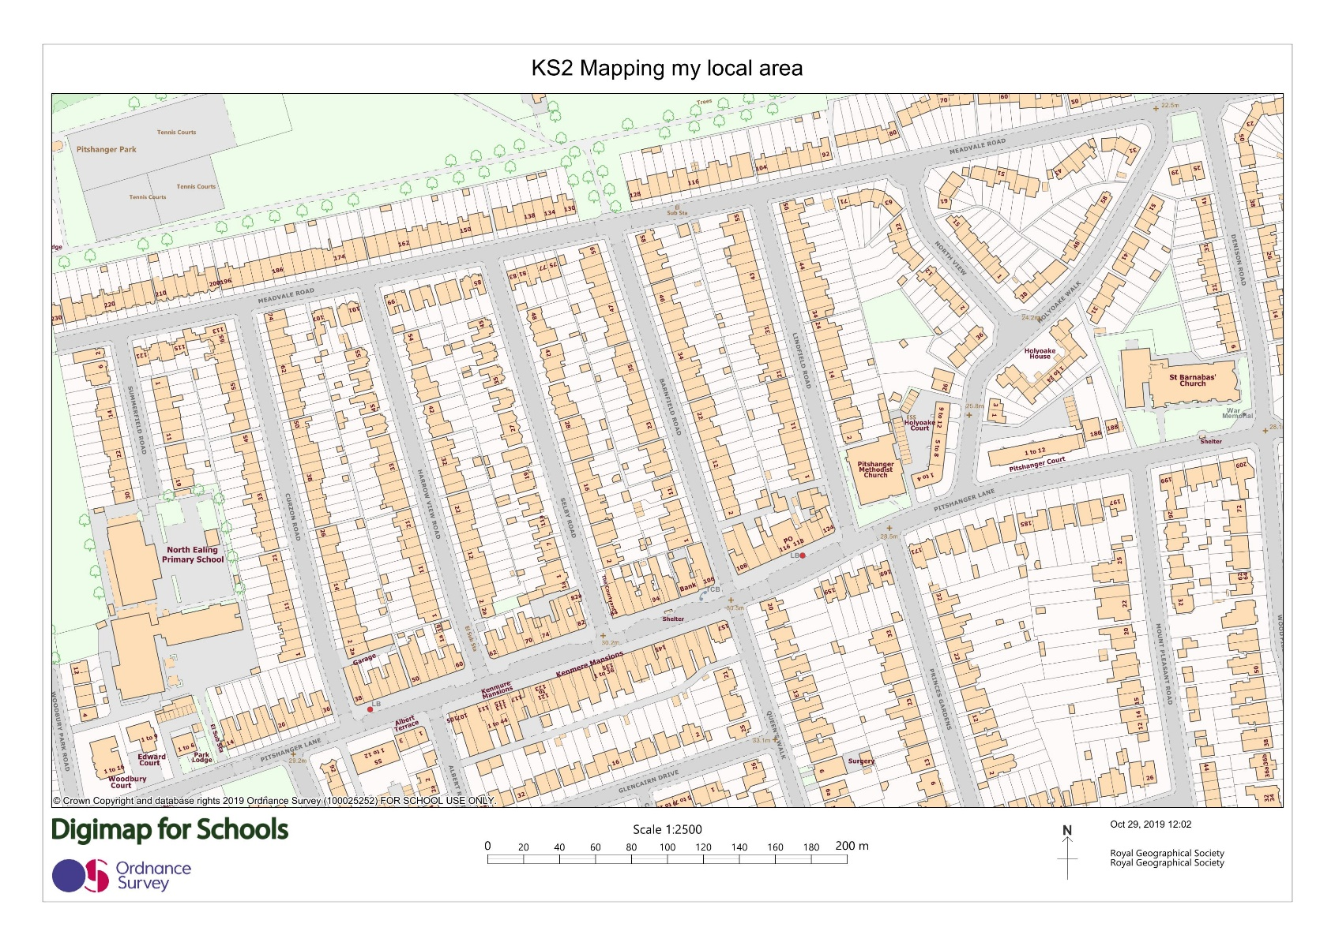
Maps of study area
School
Notes:
Print out the maps

Slide 16
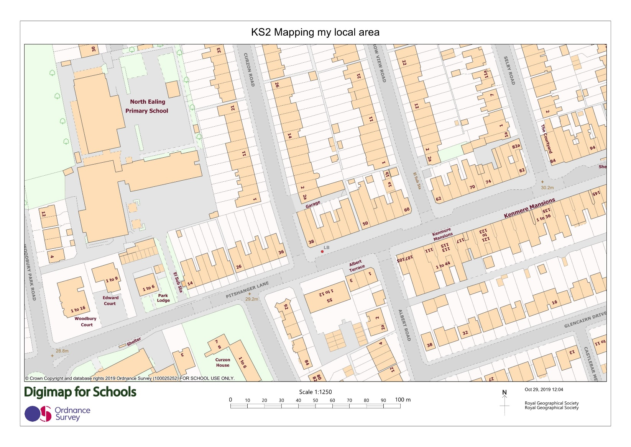
Large scale maps

Slide 17
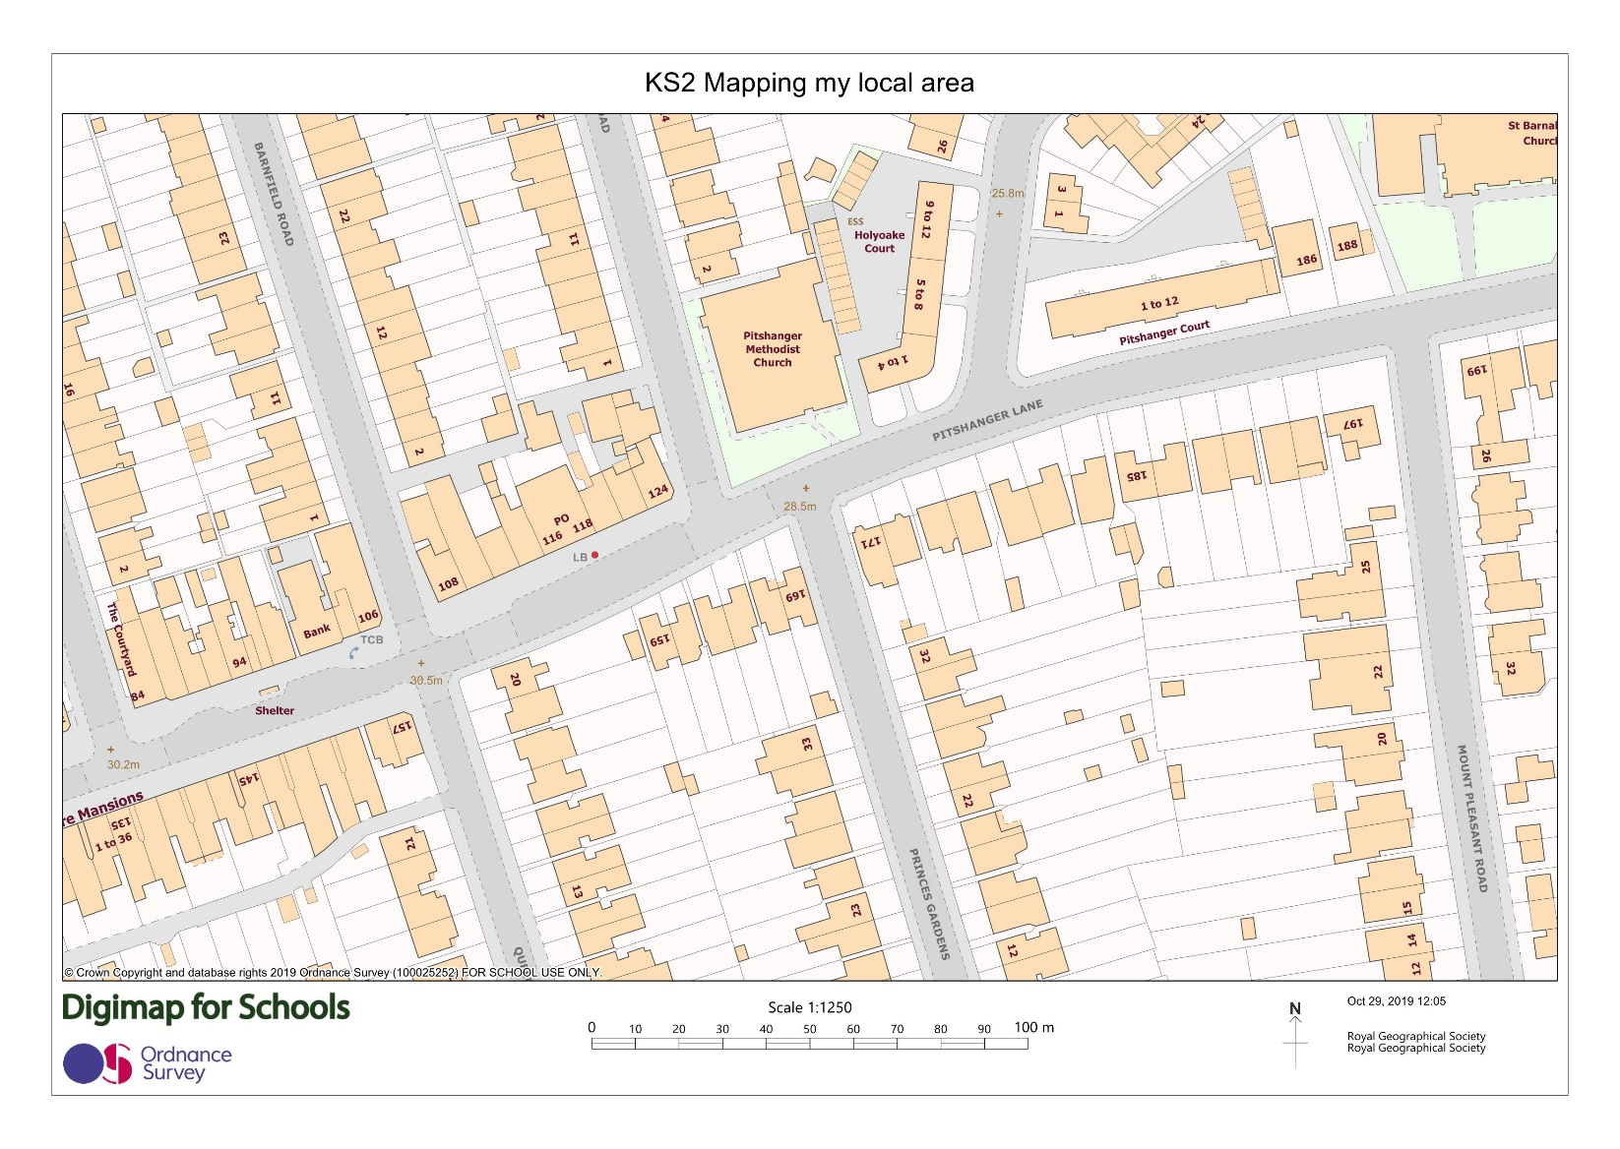
Large scale maps

Slide 18
Risk assessment
Before you collect any data, think about your safety and the risks.
Your school will have a clear policy on carrying out a risk assessment before embarking on any fieldwork.
Please refer to this and for further information please visit the RGS-IBG Fieldwork safety and planning pages.

Slide 19
Designing a key
Type
DT = Detached
SD = Semi-detached
ET = End of terrace
MT = Mid terrace
T = Terraced
Height
(number of storeys)
1
2
3
4
5
Think about the codes that you use.
On a paper map it would not be possible to use several colours on one building as they have done on the Colouring London platform

Slide 20
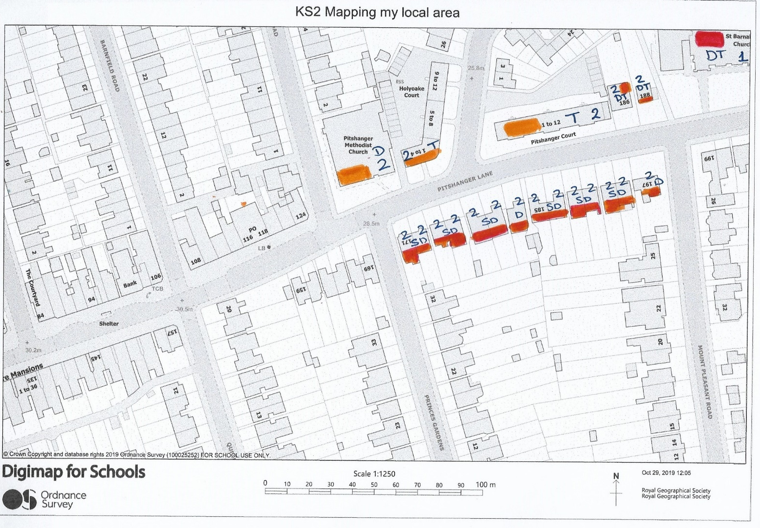
Example of field map coloured in

Slide 21
How to identify the age of the building
Using the Colouring London Building Typology handout, before you leave the classroom, agree which features of the building you will use to date it.
For example:
Construction material – brick or concrete?
Windows – single or double glazed? Wooden or PVC frames?

Slide 22
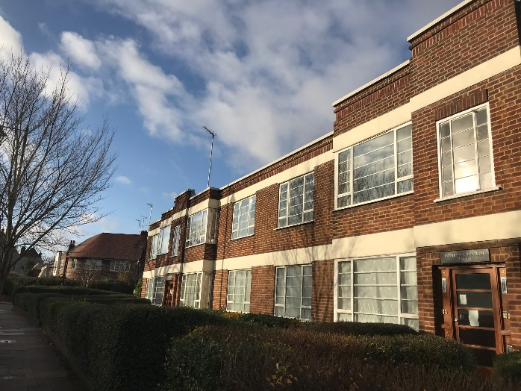
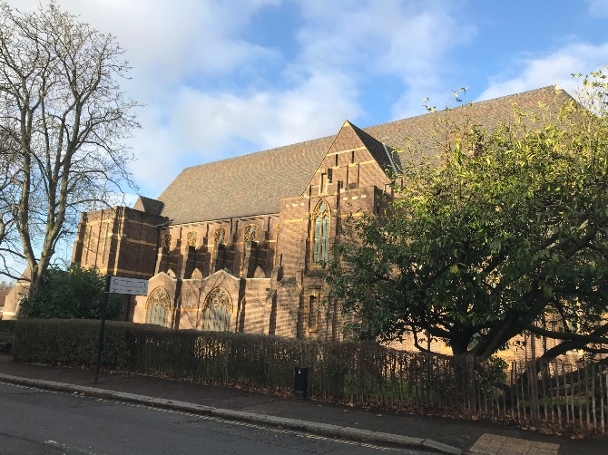
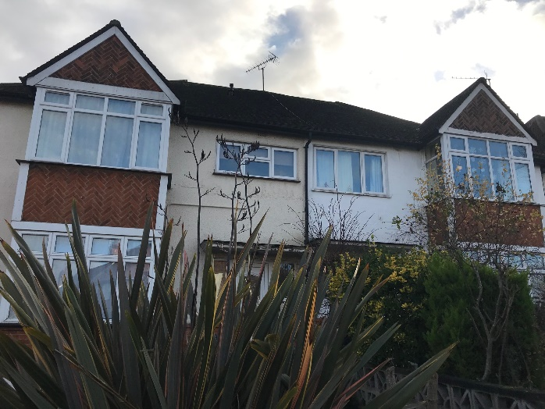
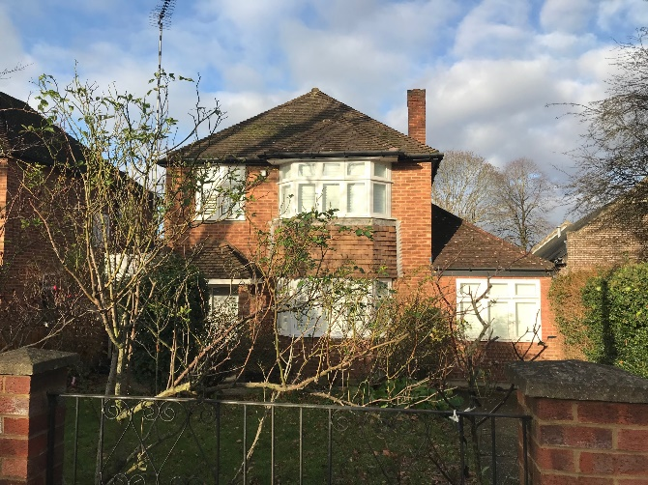
Photos of example building typologies
2
SD
1
D
2
D
2
SD

Slide 23
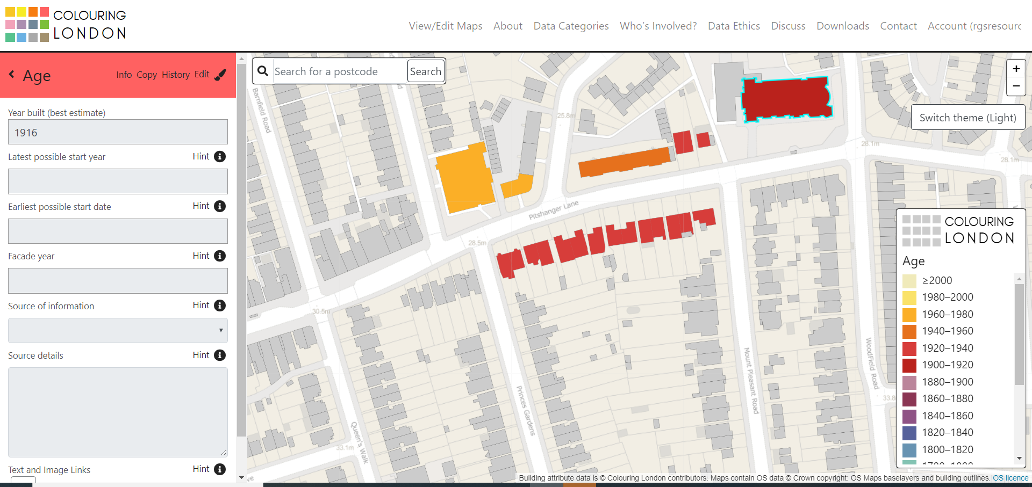
Entering data into Colouring London
Note: The teacher should enter the data. Please see KS2 and KS3 Colouring London guidance notes for teachers for further information

Slide 24
Answering your questions
Do the buildings get older as you get further away from school?
The buildings are similar in age (1920-1940) on the north side of the road
Buildings on the south side of the road are younger (some 1980s and 1990s)

Slide 25
Answering your questions
Does the type of building change as you get further away from school?
The main building type on the north side of the road was Terraced (Mid-Terraced and End-Terraced).
The buildings on the south side were more varied with Detached, Semi-Detached and Terraced being observed.

Slide 26
Answering your questions
Do buildings get taller (have more storeys) as you get further away from school?
There is no change in building height, most are 2 storeys, with the exception of a row on the south side which is 3 storeys.

Slide 27
Conclusions
Using the key enquiry questions suggested above, draw a conclusion about the age and characteristics of your local area.
e.g. There is little variation in the age or height of the buildings in my local area.

Slide 28
Conclusions
What does this tell us about how sustainable our local area is?
Age, type and height of buildings can tell us about the lifespan of the building
Knowing this helps local government to decide whether to demolish and replace buildings in cities

